Slide 1
April Brown, M.Ed., Director, Student Affairs |Veterans Services
Texas Christian University
The TCU Veterans Project: Increasing Empowerment and Visibility Through Storytelling
February 24-26, 2021 | Virtual

Slide 2
The Voices

Slide 3
How Sharing Stories led to the TCU Veterans Project
On campus, and throughout society, many veterans have sometimes felt invisible, silenced or isolated. This presentation shares the experiences of how student veterans’ conversations and sharing stories supported their journey as they transitioned to university life.
Although the initial conversations and storytelling became a way for veterans to reflect on their journey, explore their identity, and experience a sense of belonging, it also led to a project that became known as the TCU Veterans Project

Slide 4
Why Storytelling is Empowering
As stated by Sherry Hamby, Ph.D. (Sept. 2013) four benefits of sharing your story are realizing that sharing your story can help others, help you find your voice, can re-affirm our values and find peace and hope.
Reflect on a time when you shared a story or when a story was shared with you. If you would, please comment in the chat box what you remember. (empowerment, understanding, empathy,)

Slide 5
The Impact Stories Have
Storytelling can be therapeutic for the storyteller by allowing one to reflect on an experience and find meaning in one’s life. In his book, Transforming Tales: How Stories Can Change People, Rob Parkinson (2009) focuses on the therapeutic value of stories and how they can instigate real change in people’s lives.
When storytelling or oral history is written, these experiences become concrete. Stories become a form of history that is preserved and can be read by future generations.

Slide 6
What is the TCU Veterans Project?
The TCU Veterans Project is an initiative undertaken by TCU Veterans Services in collaboration with author and journalist, Ethan Casey, and the support of the TCU Discovering Global Citizenship program.
It became a collaboration with various partners, some which included the TCU Honors College, TCU Press, TCU Theatre Department, and TCU Graphic Design Department.
The TCU Veterans Project led to an honors colloquium, a book design contest, a theatre production and a book.
What’s exciting about this project is that there are endless ways for continuous opportunities to expand, evolve and to continue to amplify and empower the voices we hear.

Slide 7
Taking the Journey
Building community starts with a conversation
Ethan Casey – journalist/author
Identify possible contributors for narratives
Invite contributors to interviews
Phone
Email
In Person
(Virtual)

Slide 8
Before the Interview
Coordinate interview schedule (send reminders)
Collect permission forms and contact sheet prior to interview
Set up interview space
Audio
Lighting
Privacy

Slide 9
Interview Tips
Compile questions
Establish Rapport
Explain the Process
Allow for pauses or silence
Do not force an answer
Be Respectful
Listen
Possible Triggers (counseling resources available)
Ask a person if they are needing support
Is the anything you would like to add

Slide 10
After the Interview
Transcribe and edit interview
Share transcription with interviewee for corrections or clarification
Share final edits with interviewee
Interviewer take time to process and reflect
Share the stories

Slide 11
Why Share Stories
Veteran Engagement within the Veteran Community and Supporters
Build Community Support
Education and Understanding
Reflection
Healing
Dialogue

Slide 12
Share the Story with Others
Veterans and Military Families
Veteran Support Organizations
Campus and Community Partners
Helping Professionals
Clergy
The Community

Slide 13
Possible Venues
Classes
Panel Discussions, Dialogue and Workshops
Theatre
Readings
Book
Website
Library Archive
Radio Broadcast
Blogs
Articles

Slide 14
Veterans Project Highlights
Student Engagement
Panel Discussions and Dialogue
Theatre Production
Published Book

Slide 15
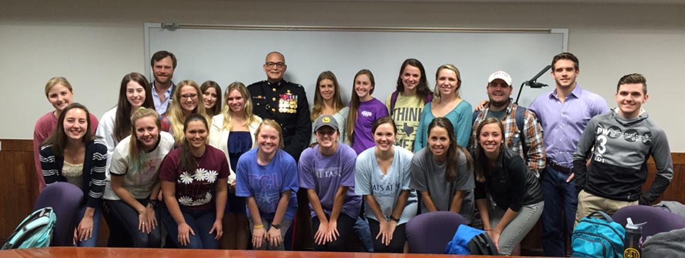
Student Engagement Bookjacket Student Contest, Honors Colloquium, Interviews, Writing Personal Narratives, Reflection
Professor Jan Ballard, Graphic Design
Honors Colloquium – Dr. Daniel Williams, Honors College

Slide 16
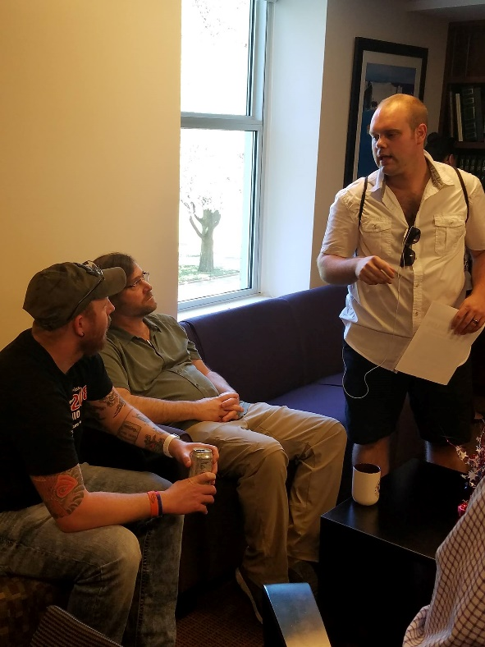
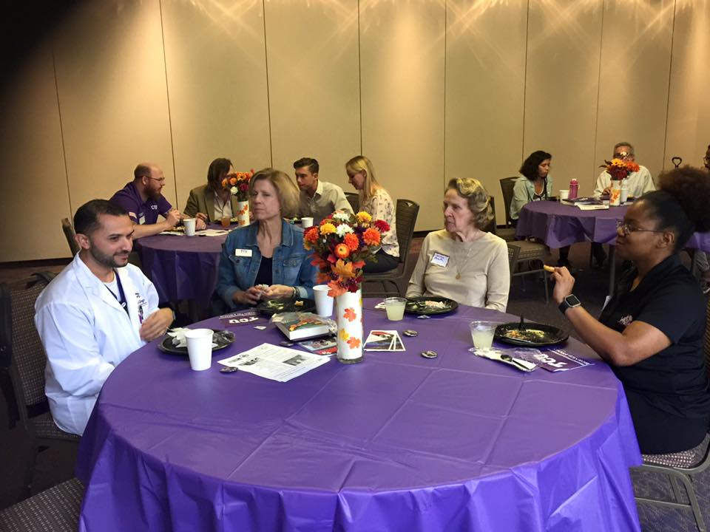
Panel Discussions and Dialogue

Slide 17
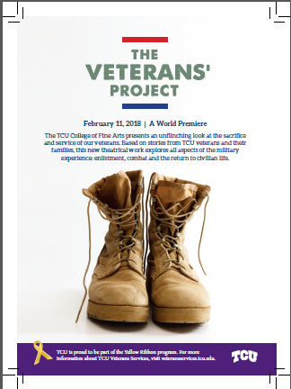
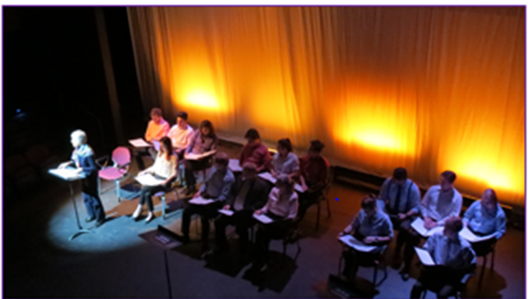
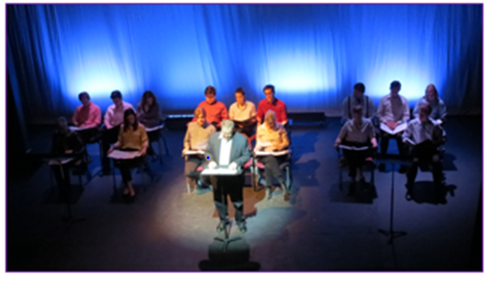
Theatre Production TCU Department of Theatre

Slide 18
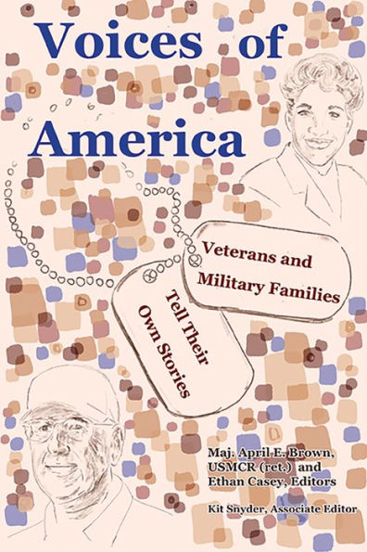
Voices of America: Veterans and Military Families Tell Their Own Stories Published November 2020
Book Cover design by TCU Alumnae and Military Family Member, Elaina Brown-Spence.
https://www.tamupress.com/book/9780875656731/voices-of-america

Slide 19
Every Story is: Unique, Empowering, Validating, Engaging
There is power in helping others through the sharing of an experience. Each person’s unique story is shown to have value when listened to or read by others. In addition, the storyteller can find their voice by being the one to tell their story.
This ownership can lead to empowerment. Stories can identify what priorities a person has and can validate the journey that is taking place. Telling a story can help a person understand challenges that they have overcome and provide a map for persistence. Stories can also create engagement with others who have shared experiences.
I invite you to consider the ways to increase the empowerment and visibility through storytelling of your veterans and others.

Slide 20
Questions?
Thank you for supporting Veterans and Military Families

