Slide 1
Political Advocacy in the Health Professions
Don Miller, Pharm.D.
Professor of Pharmacy Practice

Slide 2
What Is Advocacy?
Definitions:
Advocacy: To publicly support or recommend a cause or policy. E.g., advocacy of traditional family values or social justice. It includes activities and publications to influence public policy, laws and budgets by using facts, personal relationships, the media, or messaging to educate government officials and/or the public. Advocacy can include media campaigns, public speaking, or commissioning and publishing research.
Political Advocacy: Often known as lobbying - directly approaching legislators on a specific issue or piece of legislation. Simply raising your voice for a cause or policy that is important to you. (It does NOT mean being partisan, especially if you focus on health care issues).

Slide 3
Who Do We Advocate To?
Judicial Branch
Executive Branch
Legislative Branch
Federally the House of Representatives has 435 members who serve 2 year terms
The Senate has 100 members who serve 6 year terms
State legislatures also have 2 chambers, except for Nebraska

Slide 4
Why I am I Speaking To You?
I have done general advocacy through pharmacy organizations and my interest in rheumatology.
Have contacted local state legislators as well as federal representatives on various issues.
Currently a member of the American College of Rheumatology Committee on Government Affairs.
Have been to Washington on several occasions; have a trip on September 18-20.

Slide 5
Why Bother?
State and federal representatives are accountable to voters and want to do what is popular with voters (within the confines of their personal and party views).
All politics are local – local issues can trump general policies.
Health care issues are mostly nonpartisan. Representatives and their staff want to hear from you and make things better for their constituents. They are often unaware of nuances in policy that affect you and are glad to be better informed (thousands of bills are introduced in Congress each session).
Ten or twenty thoughtful letters/phone calls on an issue can get a lot of attention.
You hate politics? This not a political act, but part of democracy. The U.S. constitution assures us of free access to our legislators.

Slide 6
How Common is It?
National organizations - all large industries and professions routinely do lobbying year round.
Much of this is through professional full-time staff.
Some is done by members signing off on form letters.
Most organizations also host annual or biannual fly-ins to Washington for member volunteers.
If you are not at the table you are on the menu!
Hearing from local citizens is more powerful than listening to professional lobbyists.
Can be done totally on your own – but is easier through a professional organization!
Can be considered a professional obligation! Am J Health Syst Pharm 2019;76:251-3 ASHP Statement on Advocacy as a Professional Obligation | American Journal of Health-System Pharmacy | Oxford Academic (oup.com)

Slide 7
How Is It Done?
Professional organizations routinely create policies and position papers on various issues (not just political, but issues like burnout, federal regulations, reimbursement for services, etc.) Policy Statements (apha.org)
These are often developed by committees and then approved by members at annual meetings.
Sometimes these policies require a push to develop legislation, but more often make sure the organization can respond to regulations or bills that could affect the organization and its policies. If it is a regulation developed by CMS or FDA, the organization will contact CMS or FDA directly, but if it is a legislative bill, they need to work with legislators.

Slide 8
How Is It Done?
You can make a phone call, send a letter/email or schedule a meeting with your congressional reps. Personal visits are especially helpful to build a relationship with legislators and staff.
You can also donate to Political Action Committees.
All laws start with an idea. Legislative staffers take an outline of the idea to the appropriate Office of Legislative Council where it is drafted into a bill that fits the U.S. Code.
House bills are assigned number following the letters “H.R.”; Senate bills assigned a number following “S.” and must have at least one official legislative sponsor.
After the bill is officially introduced it is referred to a committee, and co-sponsors are solicited. It may sit with nothing done, or may be taken up by the committee (e.g. Health, Education, Labor and Pensions) and eventually introduced for a vote. If passed by both chambers and signed by the President, it becomes law.
A bill not taken up and passed in one Congress must be reintroduced in the next Congress for new consideration.

Slide 9
Approaching Your Legislators
Letters/emails – in person in Washington – in person at home
Know your issue.
Have bills already been introduced in the House and/or Senate? If yes, what are the bill numbers?
Has your legislator co-sponsored the bill?
If yes, thank them! Explain why it’s important to you. Ask them to push leadership to bring to a vote.
If no, explain why it’s important to you. Ask them to co-sponsor the bill (or introduce a bill).
Focus on one or two issues; don't make it political.
Tell a story of your own - typically how the issue affects you and/or your patients.

Slide 10
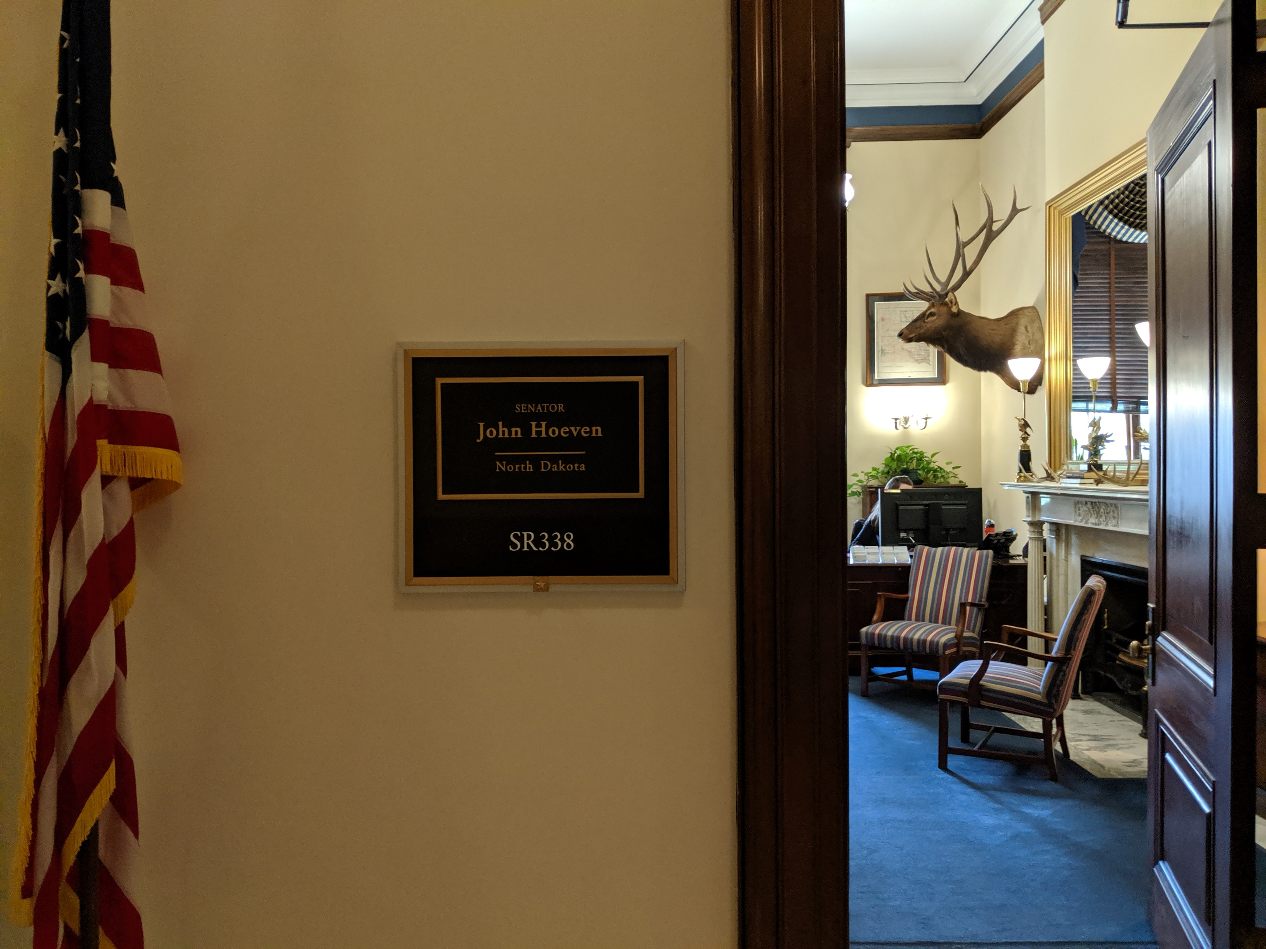

Slide 11
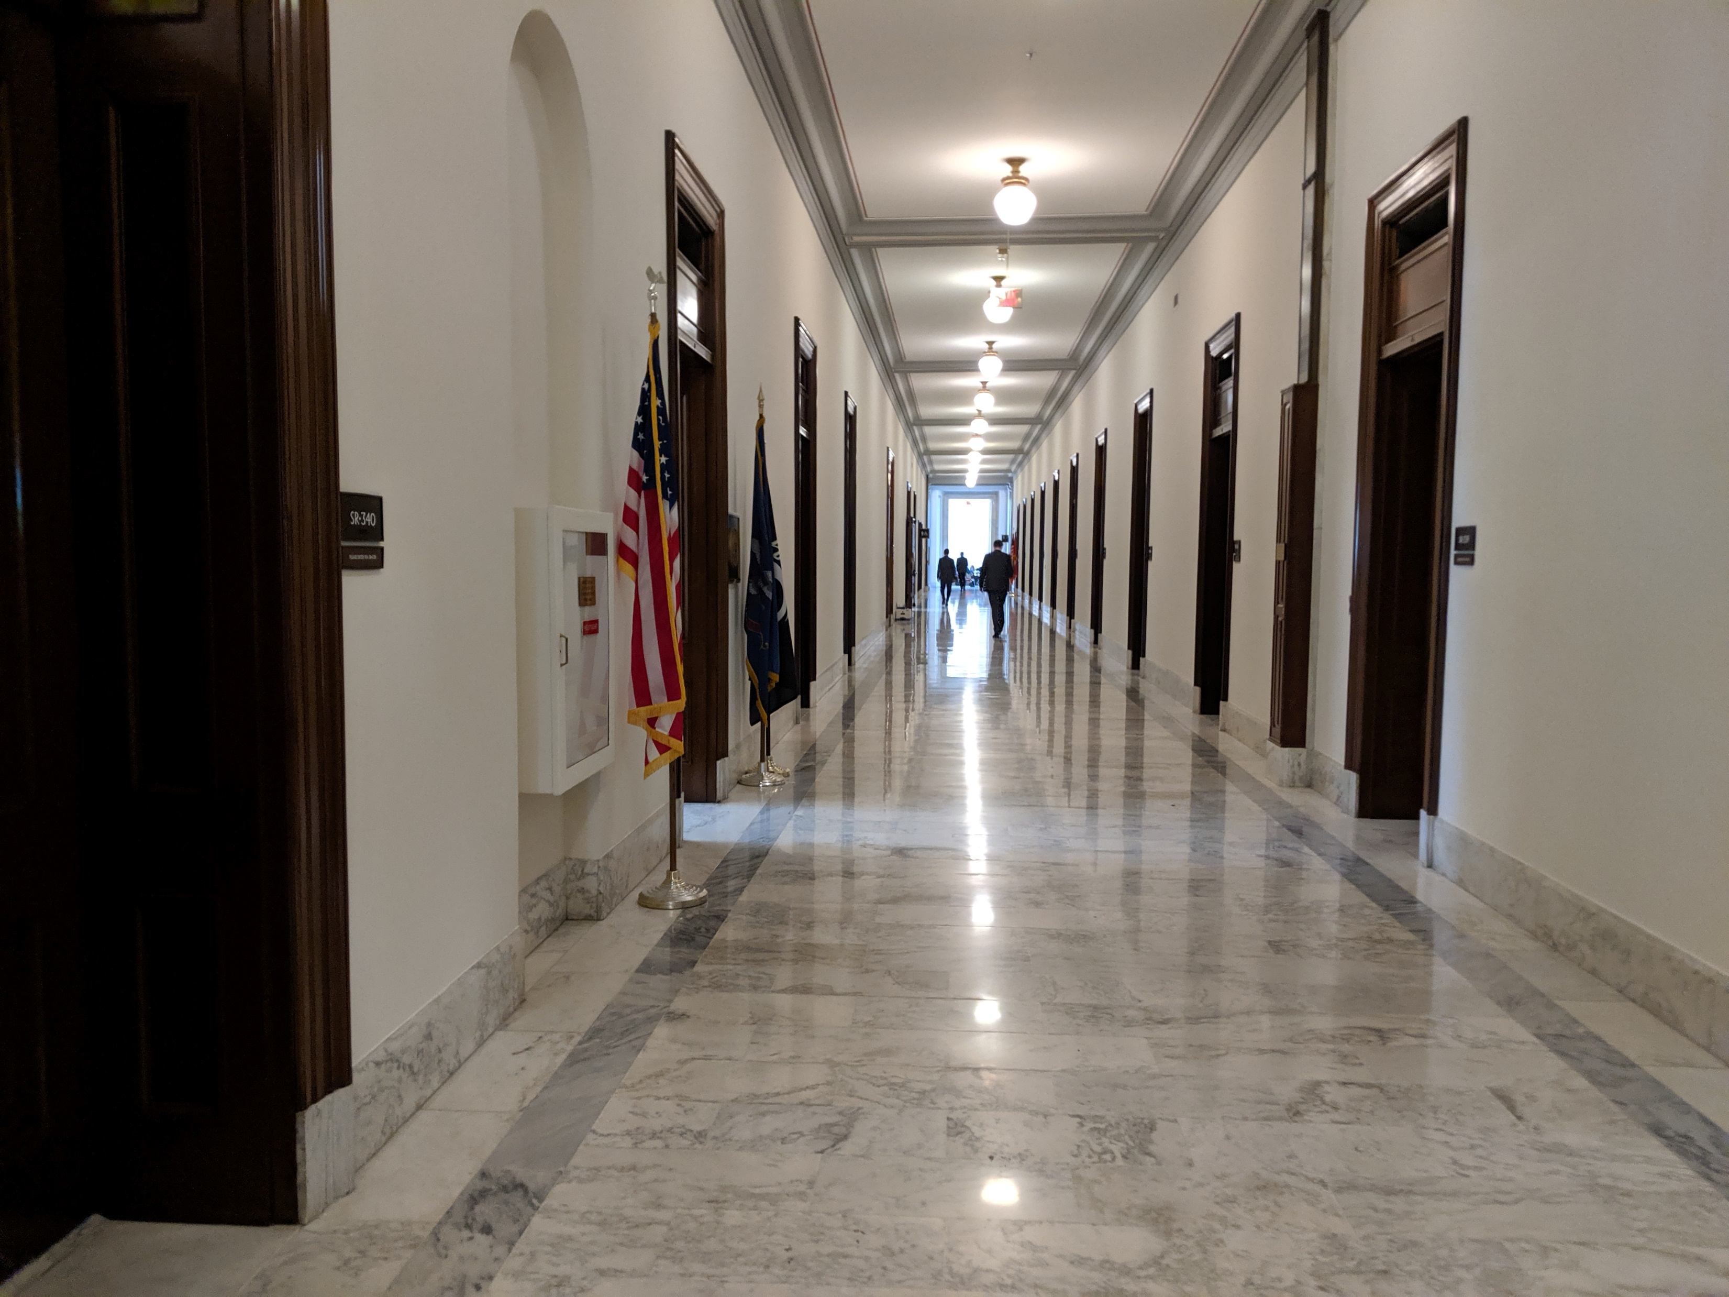
Getting Around the Capital

Slide 12
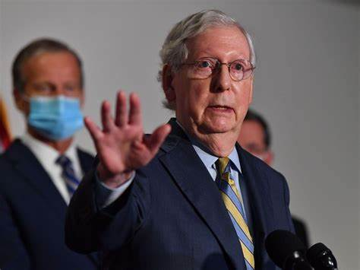
Who Knows Who You’ll See!

Slide 13
Will Something Happen Immediately?
Unfortunately, no. You have to be in it for the long haul. Many introduced bills are never passed.
Creating a relationship with representatives takes time. Most of the work and contact with you is done by legislator’s staff.
Staff are young (about 25 on average) and turn over frequently.
Many issues are on their plate, and most members of congress are focused on just a few issues.
There are usually other interests arguing on the opposite side, and the bill may cost money.
But…strength in numbers can push a bill.
Most often, many smaller bills get wrapped into major legislation when a chance arises.

Slide 14
What’s Current?
Congress recently passed the Inflation Reduction Act which includes a number of Medicare prescription drug provisions affecting pharmacists and patients:
Medicare drug negotiations: the bill will permit the HHS secretary to negotiate a maximum price for 10 of the most expensive Part D drugs beginning in 2026, increasing to 20 drugs (including Part B drug plans).
Inflation rebates: the bill will require drug manufacturers to repay the government the difference in profits above the cost of inflation on Medicare Part B and Part D drugs beginning in 2023 if they raise the price of a drug above what is needed to match inflation or face stiff penalties) by 2029, with penalties for manufacturers that do not negotiate.
Caps insulin copays: for plan years 2023–2025, the monthly copayment spent on insulin is capped at $35 for Part D and Medicare Advantage plans.
Caps out-of-pocket drug costs under Medicare Part D: starting in 2025, Medicare patients will not have to pay more than $2,000 a year.

Slide 15
Finding Information on a Current Bill
This is where your professional organizations come in. Check the legislative center on the web site of your favorite organization.
You can also use the congressional tracker at Congress.gov | Library of Congress and Legislative Search Results | Congress.gov | Library of Congress

Slide 16
Form Letters
Pre-written, editable advocacy alerts to ask your U.S. Representative and Senators to co-sponsor a bill or thank them if they have already signed on to the legislation. The form will automatically populate with the correct “please support” or “thank you” text based on your address.
ANA Advocacy (nursingworld.org) and RNAction Center (p2a.co)
American Public Health Association Advocacy for Public Health (apha.org) Action Alerts (apha.org)
American Pharmacists Association Advocacy Issues (pharmacist.com)
American Society of Health-System Pharmacists Take Action (aristotleactioncenter.com)
American College of Clinical Pharmacy Action Center (votervoice.net)
National Community Pharmacists Association Legislative Action Center | NCPA

Slide 17
One Example
H.R.2759/ S.1362 The Pharmacy and Medically Underserved Areas Enhancement Act
This bill will recognize pharmacists as health care providers for Medicare patients in underserved areas, and mandate pharmacists are fairly compensated for their patient care services.
Would amend section 1861 of the Social Security Act to add “qualified clinical pharmacists” as recognized providers under Medicare definitions.
House Cosponsors include: Dean Phillips MN-3 and Tom Emmer MN-6 (71 total). Main sponsor is GK Butterfield (D-NC)
Senate Cosponsors include: John Hoeven ND (15 total) Main sponsor is Charles Grassley (R-Iowa)
Take Action (aristotleactioncenter.com) or Medicare Provider Status Recognition (pharmacist.com)

Slide 18
Current Issues (all bipartisan)
The Future Advancement of Academic Nursing Act (S.246/H.R. 851) provides much needed funding for increasing faculty to improve the education of nurses. Nurses Don’t Need Platitudes. Congress must help end the nursing shortage crisis (p2a.co)
The Workplace Violence Prevention for Health Care and Social Service Workers Act (S.4182) and the House-passed companion bill H.R.1195 . These bills would protect workers in healthcare, social services, and other related sectors from violence by requiring employers to create workplace violence prevention plans. Take Action (aristotleactioncenter.com) or Tell the Senate to Support the Workplace Violence Bill Immediately (p2a.co)
Investing in Public Health – See Demand a Focus on Public Health (p2a.co) or infrastructure (apha.org)

Slide 19
More Current Issues
Reducing Prescription Drug prices by unveiling the practices of PBMs.
PBM reform legislation - the Pharmacy Benefit Manager Transparency Act. S.4293.
The Pharmacy Benefit Manager Accountability Study Act (S.298/ H.R.1829) that would allow the Government Accountability Office to review the business practices of PBMs. Take Action: Make PBMs Transparent & Accountable - rheum (sparkinfluence.net)
Protect Patients from Soaring Out-of-Pocket Costs. The Help Ensure Lower Patient (HELP) Copays Act (H.R.5801) requires health plans to count the value of copay assistance toward a patient plan’s cost-sharing requirements. Help Copays Act - rheum (sparkinfluence.net)

Slide 20
ND Senators www.congress.gov
Sen. John Hoeven | http://www.hoeven.senate.gov
 | 338 Russell Senate Office Building (202) 224-2551 Kennedy, Ty ty_kennedy@hoeven.senate.gov
Sen. Kevin Cramer | https://www.cramer.senate.gov
 | 330 Hart Senate Office Building (202) 224-2043 Bruno, Grace Grace_Bruno@cramer.senate.gov

Slide 21
ND House member www.congress.gov
Rep. Kelly Armstrong https://armstrong.house.gov
1740 Longworth House Office Building (202) 225-2611
Crowley, Connor Connor.Crowley@mail.house.gov
After you make any contact you will probably get an acknowledgment from your representative. Sometimes even a phone call!

Slide 22
How Else Can I Help?
Be a member of your professional organizations. Members create and vote on policies! Your dues help, but also organizations with large memberships carry more weight when they approach legislators. Your organizations will also keep you up to date on legislative issues.
Donate to those associations' political action funds (PACs). These fund advocacy activities as well support key members of Congress (on both sides of the aisle) who are sympathetic to our causes.

Slide 23
Assignment
Choose one legislative bill to look at in detail on Congress.gov (just follow the links), and check if it is co-sponsored by any local legislators. Discuss it with your table mates.
Then locate a template for contacting your federal legislators and use it to send a letter regarding that bill (to use some of the templates you may need to be a member of that organization and log in). If no one at your table can access the template you could still contact a legislator by looking up their email address and send a brief note in support of the bill!
Ideally each person will send an individual letter but you also could send one letter with all your names.

Slide 24
Resources
ACCP - Advocacy Resources
More information How to Take Action! - YouTube

Slide 25
Conclusion
Once you have gotten started in advocacy you will realize it’s not that hard or time-consuming. It can be very rewarding to get to know your congressional delegation and feel like you made a difference.
Advocacy on both state and federal issues is important.
Thanks for coming today!! I hope you stay involved.
Please take the program evaluation at: https://ndstate.co1.qualtrics.com/jfe/form/SV_9zYdVkBt2uRylqm

