Slide 1
Help!
Our Grad Students Can’t Write
Leisa Harmon, MS, CCC-SLP
Department of Communication Sciences and Disorders
2022 NDUS Teaching and Learning Conference

Slide 2
Agenda
Background
Class structure
Results
Conclusions
Future implications

Slide 3
Thank you!
8 vulnerable graduate students
My colleagues
Be seen. Be heard. BE INSPIRED.

Slide 4
Our Problems:
Significant # of students not meeting writing expectations
Needed to provide writing intervention
Be seen. Be heard. BE INSPIRED.

Slide 5
SLP Program Accreditation Standards
Written Language Proficiency
Opportunities for Remediation
Be seen. Be heard. BE INSPIRED.

Slide 6
ASHA Council on Academic Accreditation Standards for Accreditation of Graduate Education Programs in Audiology and Speech-Language Pathology
3.1.1B Professional Practice Competencies The program must provide content and opportunities for students to learn …
Use all forms of expressive communication—including written, spoken, and non-verbal communication—with individuals served, family members, caregivers, and any others involved in the interaction to ensure the highest quality of care that is delivered in a culturally competent manner.
Be seen. Be heard. BE INSPIRED.

Slide 7
ASHA Council on Academic Accreditation Standards for Accreditation of Graduate Education Programs in Audiology and Speech-Language Pathology – (Continued)
4.3 The program has policies and procedures for identifying the need to provide intervention for each student who does not meet program expectations for the acquisition of knowledge and skills in the academic and clinical components of the program.
Be seen. Be heard. BE INSPIRED.

Slide 8
Our Solution:
Prescribed special-topics writing course
Be seen. Be heard. BE INSPIRED.

Slide 9
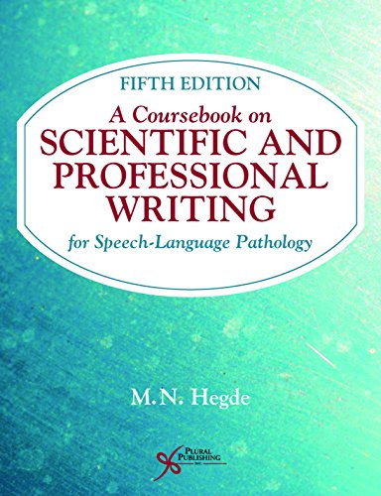
Class Format
2 SH
Graded
Textbook: Hegde, M.N. (2018). A coursebook on scientific and professional writing for speech-language pathology, 5 ed. San Diego CA: Plural.
Be seen. Be heard. BE INSPIRED.

Slide 10
Course Objectives
Use a functional writing process that incorporates critical thinking, prewriting, drafting, revising, and editing
Demonstrate proficiency with basic writing mechanics for clinical documentation
Demonstrate proficiency with basic mechanics for professional writing
Be seen. Be heard. BE INSPIRED.

Slide 11
Pedagogy
Mini-lessons
Examples
Group discussions
Quizziz.com
Peer editing
FEEDBACK
Be seen. Be heard. BE INSPIRED.

Slide 12
Requirements
Weekly assignments from textbook
Basic rules of usage (punctuation, grammar)
Basic rules of composition (concise and direct writing, parallelism, avoiding shifts, etc)
Discipline-specific writing assignments (clinical writing)
Daily progress notes
Lesson plans
Assessment reports
Home programming
Be seen. Be heard. BE INSPIRED.

Slide 13
Day 1: Setting a Positive Tone
Be seen. Be heard. BE INSPIRED.

Slide 14
Brene Brown Quote

Slide 15
Skills Quadrants
 | Good Clinical Skills | Poor Clinical Skills
Good Writing Skills
Poor Writing Skills

Slide 16
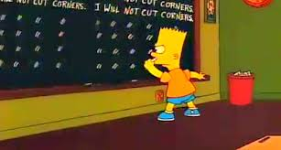
Bart Simpson cartoon

Slide 17
Surprises along the way…
Be seen. Be heard. BE INSPIRED.

Slide 18
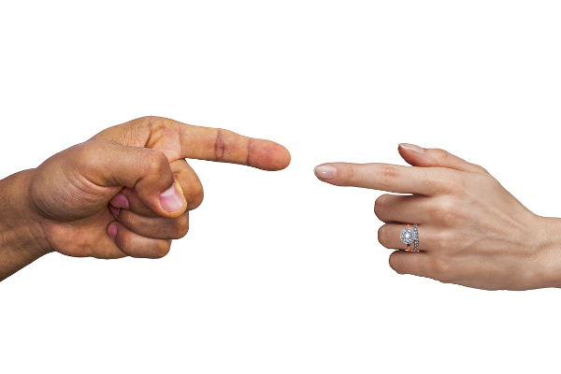
We had to get through blaming.
Be seen. Be heard. BE INSPIRED.
This Photo by Unknown Author is licensed under CC BY-NC

Slide 19
They didn’t understand process writing.
Be seen. Be heard. BE INSPIRED.

Slide 20
7 Step writing process (Education Endowment Foundation)
 | Creative | Technical
1 | Planning | Planning: Outlining
2 | Drafting | Rough Draft
3 | Sharing | ??
4 | Evaluating | Read over the entire document: do I have the format (sections, heading, red/blue squiggly lines)?
5 | Revising | Make changes to content
6 | Editing | Make changes to spelling, grammar
7 | Publishing | Submit to supervisor

Slide 21
Backward planning: Initial Progress report
Plan
Draft
Evaluate
Feb 4: Submit
Revise
Edit

Slide 22
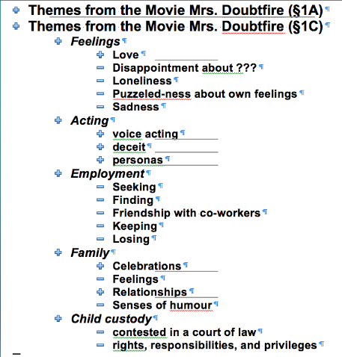
They didn’t know how to outline.
Be seen. Be heard. BE INSPIRED.

Slide 23
They didn’t know how to peer edit.
Be seen. Be heard. BE INSPIRED.

Slide 24
They liked the assignments.
Be seen. Be heard. BE INSPIRED.

Slide 25
They had valuable input: writing checklist
Be seen. Be heard. BE INSPIRED.

Slide 26
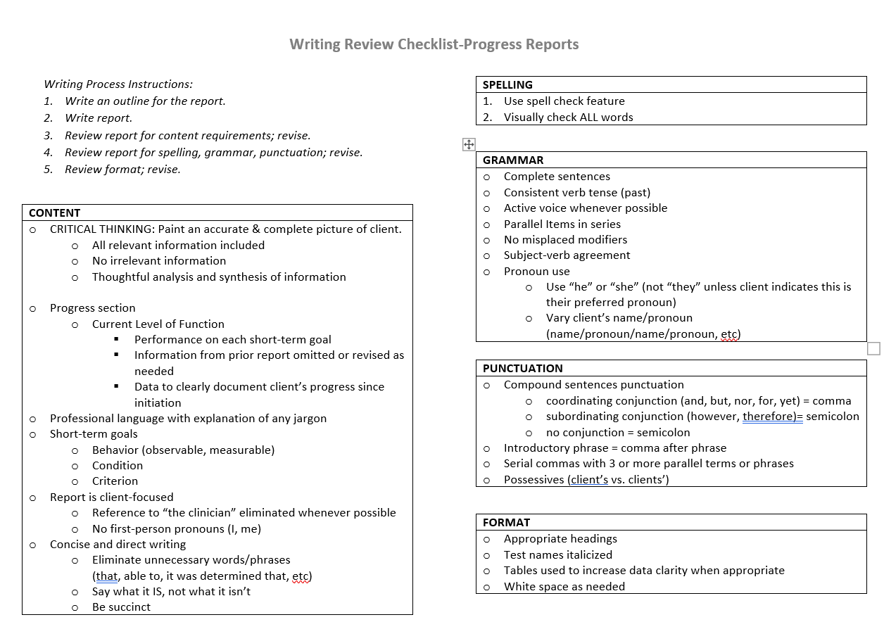
Writing Review Checklist-Progress Reports

Slide 27
They had valuable input: ideas for clinical instructors
Be seen. Be heard. BE INSPIRED.

Slide 28
They were proud of themselves.
Be seen. Be heard. BE INSPIRED.

Slide 29
Results
Be seen. Be heard. BE INSPIRED.

Slide 30
Students’ Final Grades
1 A
7 B
Be seen. Be heard. BE INSPIRED.

Slide 31
Clinical Supervisors’ Ratings of Written Communication
Student | Fall 2021 | Spring 2022 | Change
1 | 2.0 | 3.0, 4.0 | +.5
2 | 3.0 | 4.0, 4.0 | +1
3 | 2.0 | 3.5, 4.0 | +1.75
4 | 2.0 | 3.5, 4.0 | +1.75
5 | 2.0 | 4.25, * | +2.25*
6 | * | 2.75, * | *
7 | 3.25 | 4.0 | +.75
8 | 2.0 | 3.25, 3.5 | +1.35
1 – Not evident
2 - Inadequate
3 – Present
4 – Adequate
5 – Consistent
* - missing data
Acceptable Level = 3.5
Be seen. Be heard. BE INSPIRED.

Slide 32
Writing Attitude Survey (Podson, 1997; Rafanello, 2008)
20 questions
Higher score = more positive and confident about writing
Example Questions | Strongly Disagree | Disagree | Don’t Know | Agree | Strongly Agree
I avoid writing whenever possible. | 5 | 4 | 3 | 2 | 1
I have no fear of my writing being evaluated. | 1 | 2 | 3 | 4 | 5
I look forward to writing down my ideas. | 1 | 2 | 3 | 4 | 5
I am afraid of writing when it might be evaluated. | 5 | 4 | 3 | 2 | 1

Slide 33
Writing Attitude Survey

Slide 34
Writing Behavior Inventory (Podson, 1997; Rafanello, 2008)
16 questions
Higher scores = “more efficient & effective writing behaviors”
Question Examples
I gather information I need before I begin writing.
I use prewriting techniques to generate ideas.
I identify the specific purpose for each document.
Example Questions | Never | Rarely | Don’t Know | Some- times | Always
I set aside a specific time during the day to work on writing tasks. | 0 | 1 | 2 | 3 | 4
I gather information I need before I begin writing. | 0 | 1 | 2 | 3 | 4
I use prewriting techniques to generate ideas (for example, outlining, mapping, freewriting). | 0 | 1 | 2 | 3 | 4
I identify the specific purpose for each document. | 0 | 1 | 2 | 3 | 4

Slide 35
Writing Behavior Inventory

Slide 36
Final Writing Sample
Prompt: A Reflection on the Past, Present, and Future of My Writing
Students’ scores /20 pts
Content (10 points)
All 8 students = 10
Writing (10 points)
Range = 7.0 – 9.9
Total Score Range = 17 - 19.9 SD= 1.0677

Slide 37
Course Evaluations
Be seen. Be heard. BE INSPIRED.

Slide 38
Qualitative
Faculty comments (anecdotal)
Students’ final writing project: Past, Present, and Future of My Writing
Increased confidence in writing skills
Need for further improvement
Be seen. Be heard. BE INSPIRED.

Slide 39
Conclusions
Prescribed writing intervention class improved most students’ clinical writing skills.
Key features
Writing process instruction
Outlining and timelining
Peer editing
Be seen. Be heard. BE INSPIRED.

Slide 40
Future Implications
Viable option for writing remediation for struggling students
Small class size is critical for adequate feedback
Consider allowing students to “opt in”
Gather more data
Interrater reliability
Qualitative analysis
Be seen. Be heard. BE INSPIRED.

Slide 41
Resources
Burrus, A. & Willis, L. (2017). How to write, talk, and act like a clinician, 2nd edition. San Diego, CA: Plural.
American Speech-Language Hearing Association (2022). Accreditation Handbook: 2020 Standards for accreditation of graduate education programs in audiology and speech-language pathology. Retrieved from https://caa.asha.org/siteassets/files/accreditation-standards-for-graduate-programs.pdf.
American Speech-Language Hearing Association (2020). 2020 Standards and implementation procedures for the certificate of clinical competence in speech-language pathology. Retrieved from 2020 Certification Standards in Speech-Language Pathology (asha.org).
Education Endowment Foundation. Improving literacy in key stage 2: Guidance report, 2nd ed. Retrieved from https://d2tic4wvo1iusb.cloudfront.net/eef-guidance-reports/literacy-ks2/EEF-Improving-literacy-in-key-stage-2-report-Second-edition.pdf?v=1637857731, 19 May 2022.
Flowerdew, J. and Costley, T. (2017). Discipline-specific writing: Theory into practice. Oxfordshire, UK: Routledge.
Goldfarb, R. & Serpanos, Y. (2014). Professional writing in speech-language pathology and audiology, 2nd edition. San Diego, CA, Plural.
Halvorson-Bourgeois, B., Riotte, M., & Smith, S. (2020) Guiding students’ clinical writing and critical thinking: Utilizing scholarly teaching to develop and implement a clinical writing rubric. Teaching and Learning in Communication Sciences & Disorders, 4(2).
Hegde, M.N. (2017). A coursebook on scientific and professional writing for speech-language pathology: Fifth edition. San Diego, CA: Plural.
Podsen, I.J. (1997). Written expression: The principal’s survival guide. Larchmont, NY: Eye on Education.
Rafanello, D. (2008). Writing well: It’s all about attitude. Professional Writing Exchange, May/June 2008. Retrieved from ww2.csudh.edu/ccauthen/575S12/attitude-surv.pdf#:~:text=writing%20well%3A%20it’s%20all%20about%20attitude%20Professional%20writing%2C,amount%20of%20time%20they%20dedicate%20to%20writing-related%20tasks.
Rawson, R.E., Quinlan, K.M., Cooper, B.J., Fewtrell, C. & Matlow, J.R. (2005). Writing-skills development in the health professions. Teaching and Learning in Medicine, 17(3), 233-239.
Schneider-Cline, W. (2017). Developing graduate students’ self-regulation and critical thinking during a clinical writing workshop. Teaching and Learning in Communication Sciences & Disorders, 1(1).
Stein-Rubin, C. & Fabus, R. (2012). A guide to clinical assessment and professional report writing in speech-language pathology. Clifton Park, NY: Delmar.
Willis, L. & Piazza, L. (2019). Developing and using a rubric to provide feedback and improve CSD clinical writing. Teaching and Learning in Communication Sciences & Disorders, 3(2).
Wisconsin Department of Public Instruction. What is disciplinary literacy? Retrieved from https://dpi.wi.gov/sites/default/files/imce/cal/pdf/section2.pdf.

Slide 42
Contact Information
Leisa.harmon@minotstateu.edu

