Slide 1
Metacognitive Reflection:
What is it and how can we foster it in our classrooms?
Drs. Katie Wissman & Jenni Momsen
Teaching and Learning Conference 2024
North Dakota State University

Slide 2
Getting in the (Meta) Mindset
Chat with your table about the following questions:
What classes do you typically teach? What is the average size?
Do you talk with your students about effective learning strategies? If yes, which ones? If no, how come?
Are you familiar with the concept ‘metacognitive reflection’? How would you define it?
Have you ever incorporated metacognitive reflection technique into your teaching?

Slide 3
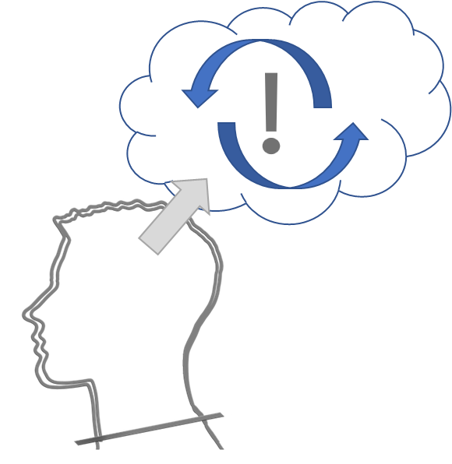
Metacognitive Reflection:
What Is It and How Can I Use It?
The planning, monitoring, and evaluating of one’s learning
Incorporate the technique into your classroom practices
Today: some examples!
Notes:
An awareness or analysis of one’s own knowledge–figuring out what one does versus does not know. The ability to understand, control, and manipulate one’s cognitive processes.
(1) Develop a plan before starting a learning task; (2) Monitoring understanding; (3) Evaluate thinking after completing the task.
Providing students with information on the progress of their learning and the opportunity to evaluate their learning
This is super important for our students success, as it helps them understand how to regulate their thinking and their goal-directed behaviors.

Slide 4
Written Reflection
Preparing
Being explicit about the purpose
Notes:
Context: Intro to Psych, with ~250 students
A broader grain size, focused on general understanding of class content (vs specific to an assignment/exam)
Out-of-class assignment
Easily adaptable - more/different questions, also done via Flip(grid)

Slide 5
Written Reflection
Evaluating
Reflect on overall learning of content
Notes:
Context: Intro to Psych, with ~250 students
A broader grain size, focused on general understanding of class content (vs specific to an assignment/exam)
Out-of-class assignment

Slide 6
Written Reflection
Identifying
Recognize key content
Articulate rationale
Acknowledge areas of difficulty
Notes:
Context: Intro to Psych, with ~250 students
A broader grain size, focused on general understanding of class content (vs specific to an assignment/exam)
Out-of-class assignment

Slide 7
Written Reflection
Connecting
Relating class material to existing knowledge
Notes:
Context: Intro to Psych, with ~250 students
A broader grain size, focused on general understanding of class content (vs specific to an assignment/exam)
Flexible in how to implement: I’ve typically done this as a writing assignment, but I’ve also used this on Flip(grid).

Slide 8
Exam Wrappers
Designed to support students’ development of self-regulated learning skills - including metacognition
Exam wrappers are
Short interventions
Easy to complete
Adaptable to many course contexts
Questions focus on three areas
How did you prepare for the exam?
What errors did you make on the exam?
How will you study for the next exam?

Slide 9
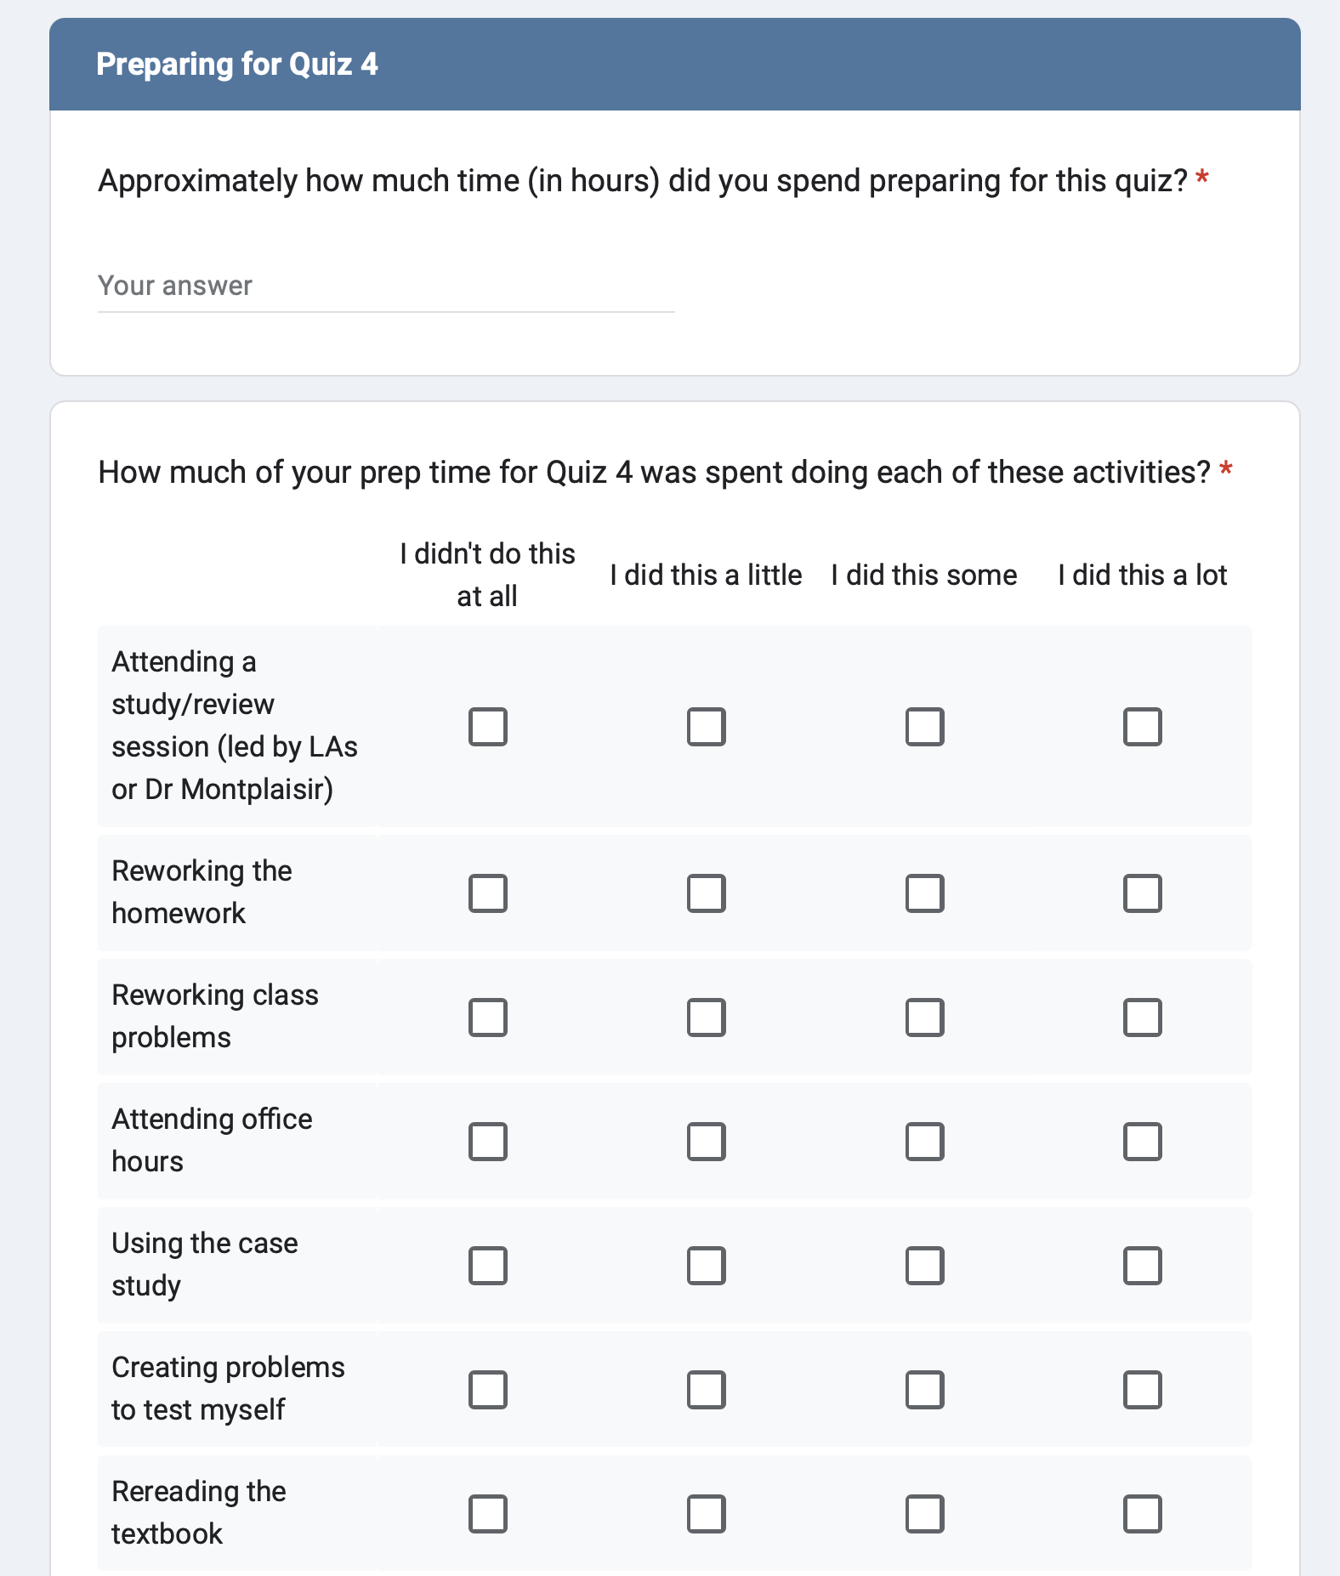
Preparing
Ask about cramming or spaced studying!
Study approaches
Evidence-based practices (retrieval/self testing, elaboration, etc)
Collaborative learning
Using course resources (e.g., office hours, review sessions, etc)
Notes:
Context: Intro Bio with ~135 students; taught in AGHill 130/132 (SCALE UP or active learning environment)
Exam wrappers are developed at the level of an exam, with elements that dive down to the item level
I do these as out-of-class assignments, but you can modify these to be done in class
I create them as a google form, but this could be done within Bb or using Qualtrics, even pen & paper
First step: have students identify how they prepared for the exam

Slide 10
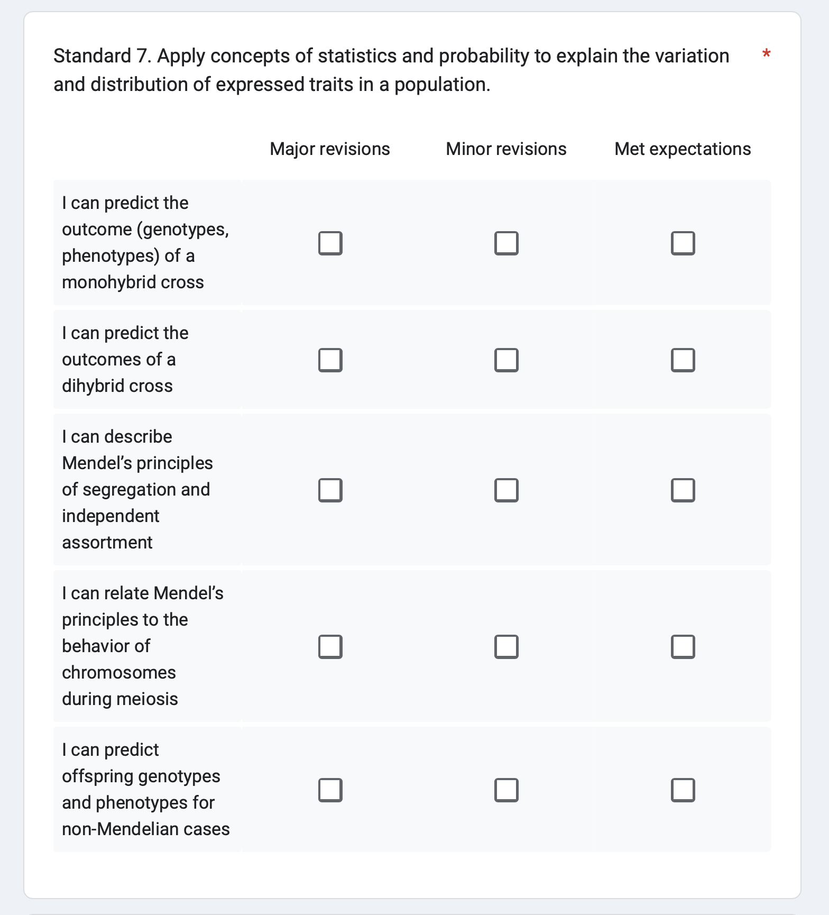
Interpret exam feedback
Where do you meet expectations?
Where do you need to grow?
Notes:
Second step: identify areas in need of improvement. What were the errors made? Are there any patterns to my errors (e.g., I struggled with calculations, I didn’t understand a particular concept, etc)

Slide 11
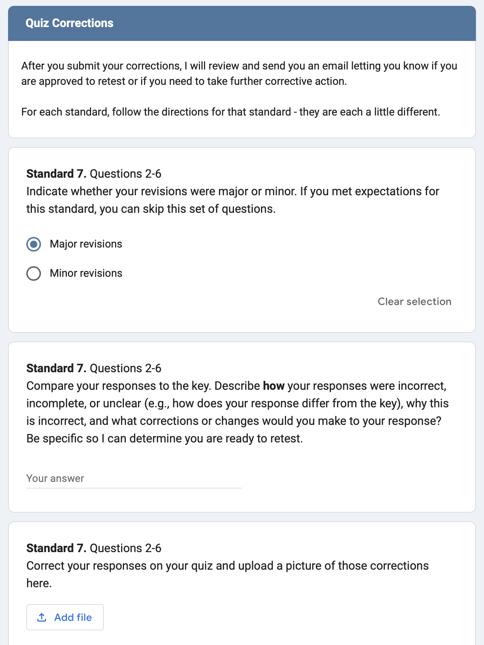
Interpret the feedback
Identify where thinking went wrong or where knowledge was incomplete
Make corrections
Guide students with more specific questions
Notes:
Continued unpacking of errors, but at the item level. This is considered reflexive exam analysis, when it’s at the level of the item.

Slide 12
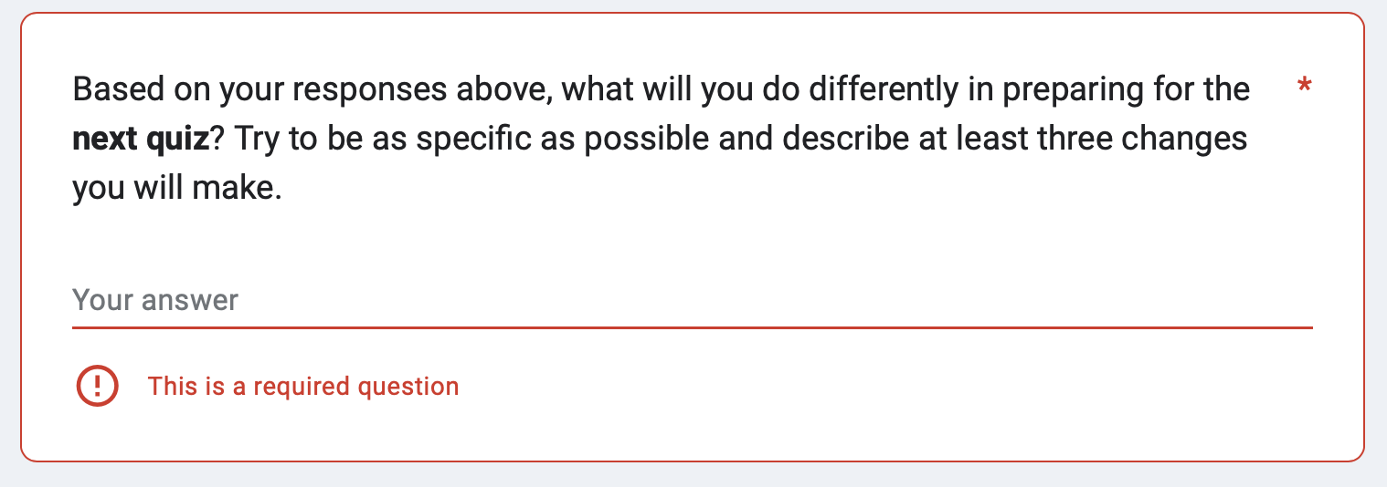
Plan for future learning
Prompt students to think about changing study approaches, study timing
Notes:
Step 3: plan for future learning. What should I change in order to do better next time?

Slide 13
Condensed Exam Wrapper
How did you do on the exam?
Better than I expected
About how I expected
Worse than I expected
Do you think your grade reflects your knowledge of the exam content (taking into account how much you actually studied)?
Yes
No
Unsure
If you were happy with your grade, what is something you will do again to prepare for the next exam?
If you were unhappy with your grade, what is something you will do differently to prepare for the next exam?
Notes:
Context: Intro to Psych, with ~250 students
A broader grain size, focused on overall exam performance
Used with clickers in class session after each exam, and about ~1 leading up to exam, ask students to revisit as they prepare to study for upcoming exam. And then give a few minutes to look at schedules and plan out when they will do the things they say they would do to prepare this time around

Slide 14
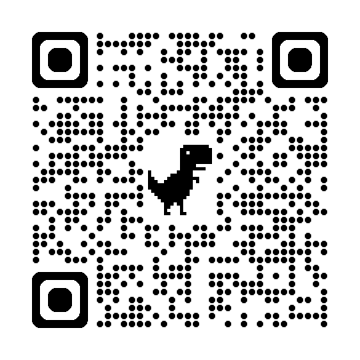
Putting It Into Action!
Let’s reflect:
How might you incorporate metacognitive reflection into your own classroom activities or assessments?
What challenges or concerns do you have about implementing this technique in your class?
Can you think of any resources that would be helpful for you?
Other lingering wonderings, thoughts, or ideas?!
Resources

Slide 15
Thank you!

Slide 16
Three Tips for Metacognitive Reflection
#1: Provide students with opportunities to plan for their learning, monitor their understanding, and evaluate their thinking.
#2: Share with students how engaging in metacognitive reflection promotes their learning. Repeat frequently!
#3: Introduce students to evidence-based learning practices, like retrieval practice, space practice, interleaving, elaboration, and concrete examples.

