Slide 1
Lessons Learned from Research on Student Veterans' Transition
to Nursing Education

Slide 2
Research Team Members
Deborah L. Sikes, DNP, RN, CNE- Texas Tech University Health Sciences Center, Lubbock, TX, USA
Brenda Elliott, PhD, RN, CNE, ANEF - Messiah University, Mechanicsburg, PA, USA
Katie A. Chargualaf, PhD, RN, CMSRN, CNE, FAAN - University of South Carolina Aiken, Aiken, SC, USA
Barbara J. Patterson, PhD, RN, FAAN, ANEF - Widener University, Chester, PA, USA
Huaxin Song, PhD - University of Texas at Tyler, Tyler, TX, USA
Myrna Armstrong EdD, RN, FAAN, Marble Falls, TX, USA

Slide 3
Presentation Goals
At the end of this presentation, participants will be able to:
Transfer evidence-based strategies related to nursing student veterans to expand military-connected student services.
Describe factors identified with successful matriculation to graduation for student veterans enrolled in Veteran to Bachelor of Science (VBSN) programs.
Identify at least three resources needed by faculty and staff to support student veterans in higher education.
Explore research gaps and opportunities related to student veterans’ success.

Slide 4
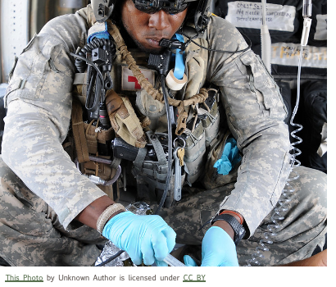
A team…with common goals
October 2018
Backgrounds
  Military veterans
  Military spouses
  Military family members
Locations
  Italy
  Pennsylvania
  South Carolina
  Texas
Notes:
The goals of the research team include improving the experiences of student veterans in higher education, supporting matriculation to graduation, and preparing faculty to engage with student veterans. This presentation builds upon the dissemination efforts of the research team to increase awareness of student veterans needs by keeping this topic relevant to higher education leaders.

Slide 5

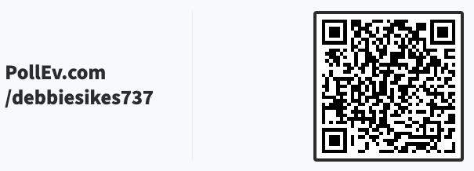
Participation is key

Slide 6
Increasing Awareness of Student Veterans Needs in Higher Education
Actualizing veterans education in nursing (Sikes et al, 2018)
Student veterans’ transition experiences (Patterson et al., 2019a)
Facilitating learning for student veterans (Patterson et al., 2019b)
Lessons learned serving military students (Sikes et al., 2020)
Translating military and education training to meet civilian academic requirements (Hurlbut et al., 2020)
Notes:
A little background on the prior work done by the authors include a publication in 2018 by Sikes and colleagues, describing the development of a Competency Assessment Placement (CAP) model developed to award prior learning credits for veterans with military healthcare education and training. Direct assessment of competencies was based upon performance on standardized assessments allowing prior learning credit for nursing courses for military veteran students enrolled in a VBSN program.
Patterson and colleagues (2019a) conducted a study to understand student veterans’ transition experience and found that student veterans are challenged by the drastic change in structure and culture from the military to higher education. The researchers also found that veterans returning to school focused on learning and sought meaning and purpose in pursuit of their nursing degree.
In a second related study, Patterson and colleagues (2019b) gleaned input from student veterans on how best to facilitate their learning in the classroom. The findings highlighted embracing core values, team-based learning, communication, and leveraging leadership skills
In 2020, Sikes and an additional team, including the assistant vice president for student affairs, shared lessons learning from serving military students. The authors discussed student services for military and military veteran students and how one university implemented the services, including providing a veteran advisor, a veteran liaison, military-friendly policies, services, and resources.
An additional publication by Hurlbut and colleagues in 2020 reviewed methods used by multiple VBSN programs to provide academic prior learning credits in nursing.
With these studies and publications as a foundation, the goals of the research team formed in 2018 included improving the experiences of student veterans in higher education, supporting matriculation to graduation, and preparing faculty to engage with student veterans. This presentation builds upon the dissemination efforts of the research team to increase awareness of student veterans needs by keeping this topic relevant to higher education leaders.

Slide 7
Background
Joining Forces campaign
(The White House, n.d.a; The White House, n.d.b)
Have You Ever Served?
(American Academy of Nursing, 2013)
Health Resources Services Administration (HRSA), Nurse Education, Practice, Quality and Retention Veterans’ Bachelor of Science Degree in Nursing (NEPQR-VBSN) grants
(Bureau of Health Workforce, n.d.)
Notes:
Military veterans from the Iraq and Afghanistan wars are unique, characterized by their all-volunteer service, and increased gender, racial, and ethnic diversity. In addition, there are almost one million Reserves and National Guard members, and the largest contingency of women (> 15%) within today’s Total Force (Texas Workforce Investment Council [TWIC], 2019). Over 175,000 became veterans when they separated from the military in 2017 and almost half of the over 2.5 million deployed men and women service members of the Iraq and Afghanistan wars produced an enrollment surge into the nation’s colleges and universities (Holian & Adam, 2020; Postsecondary National Policy Institute [PNPI], 2019; TWIC, 2019).
In 2012 former First Lady Michelle Obama and current First Lady, Dr. Jill Biden established the Joining Forces campaign, encouraging all sectors of society to support Veterans and their families. Nursing responded in like with the development of the Have You Ever Served? campaign to encourage healthcare providers to address military and veterans’ needs upon initial intake. A list of questions and a pocket card were developed to inquire in a culturally sensitive manner about prior military service, including general areas of concern related to personal or familial history of military service, potential exposures to combat or combat-related illnesses including PTSD, military sexual trauma, traumatic brain injury, and suicide risks. In 2015, the Health Resources Services Administration (HRSA) established the Nurse Education Practice, Quality and Retention Veterans’ Bachelor of Science Degree in Nursing grants program. One of the schools represented by this body of research received a VBSN grant and established a VBSN track for veterans with prior military health care training and experiences.

Slide 8
Three Research Team Studies
Predictors of student veterans progression and graduation in VBSN programs.
(Sikes et al., 2020)
Faculty perspectives of teaching and facilitating learning transfer in VBSN programs.
(Chargualaf et al., 2022)
Assessing knowledge, attitudes, and confidence in nurses and nursing students in caring for military veterans and their families. (Elliott et al., 2023)
Notes:
Dyar (2016) conducted a scoping review and found that service members faced several barriers transitioning to the classroom which include stigma, difficulty with peer relationships (especially due to variations in life experience), navigating higher education, and personal and financial responsibilities. Student veterans bring many strengths to higher education and nursing to include leadership, teamwork, and global awareness to name a few. Yet, military-connected students continue to face multiple challenges when pursuing a degree in higher education (Chargualaf et al., 2022; Patterson et al., 2019a; Sikes et al., 2020).

Slide 9
Predictors of VBSN Progression/Graduation
Purpose & Method
Identify predictors of student veterans’ (SV) progression and graduation rates in VBSN programs
A descriptive correlational retrospective design
Examined 282 student veterans’ education records from VBSN programs
Notes:
As a response to the growing nurse shortage and the Joining Forces (Obama White House, n.d.) initiative, in 2013 the U.S. Department of Health and Human Services Health Resources Services Administration (HRSA) began accepting proposal applications for NEPQR- VBSN Program grants. The overarching goal of the VBSN program “strengthens the quality of health care and expands the nursing workforce through increased enrollment, progression, and graduation of veterans from baccalaureate nursing programs. “ (HRSA, 2016). The intent was to assist veterans to transition into nursing by maximizing knowledge and skills gained during military service to increase employability. Specifically, the NEPQR-VBSN grants were provided to expand the nursing workforce using innovative models to educate former military healthcare providers while incorporating options for awarding academic credit for military experiences and training (HRSA, 2016).
A descriptive, correlational, retrospective design was used to analyze de-identified archival SV data from four TX NEPQR-VBSN programs. This approach was used to determine associations between various program reporting attributes in relationship to student success (progression and completion/graduation rate). There were no exclusion criteria. Ethics approval was received from the principal investigator’s university, as well as each research team member received approval from their respective institutional review board (IRB) to serve as study investigators. - I don’t think this is needed.

Slide 10
Predictors of VBSN Progression/Graduation
Research Questions
What were the relationships among gender, age, ethnicity, veteran status, disadvantaged background, rural residential background, race, leaving the program before program completion and graduation rates?
What reported HRSA variables predicted the likelihood of student veterans enrolled in Texas BSN programs leaving the program before completion and graduation rates?

Slide 11
Predictors of VBSN Progression/Graduation
Annual VBSN Grants Criteria Reviewed
Characteristic
Type of training program
Program characteristics
Individual demographic characteristics
(obtained via unique training ID)
Individual background and program status
Student military service status
Criterion
Pre-licensure (generic) BSN program
Delivery mode for entire nursing program: distance learning only, hybrid, or campus-based only
Sex: male or female
Year of birth
Ethnicity: Hispanic/Latino or Non-Hispanic/Non-Latino
Race: American Indian or Alaska Native, Asian, Black or African American, Native Hawaiian or Other Pacific, White
Residence: rural and/or disadvantaged
Enrollment status: full-time, part-time, or both
Academic or training year: undergraduate year 1, 2, 3, or 4
Program completion: left before program completion, graduated/completed the program
Veteran, Reservist/National Guard, active-duty military

Slide 12
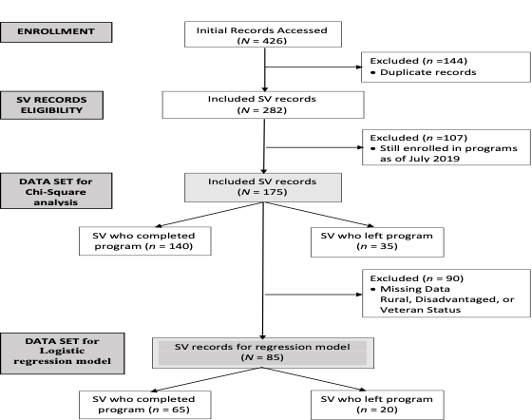
Predictors of VBSN Progression/Graduation
Flowchart of Student Veteran Records
Notes:
Data records included 282 SVs who completed (n = 140), were still enrolled (n = 107), or left (n = 35) their program in one of four VBSN programs in TX between 2016 and 2019. The sample included a near equal number of male and female SVs with a majority born after 1977 (Generation X). Most subjects were White (n = 219), non-Hispanic (n = 214), and not actively serving in the military (veteran, n = 199). Most SVs reported living in a non-rural area (n = 112) and 20.5% described having a disadvantaged background (n = 58). The majority of SVs attended classes delivered in a hybrid format (n = 156) with fewer attending classes strictly online (n = 79) or on campus only (n = 47).
To determine which factors most impacted graduation rates, only SV records whose completion status could be determined before July 2019 were included in analysis using Chi-Square (N = 175). SV records with missing data (n = 90) were removed from further analysis. The data set for the logistic regression model included 85 records with no missing data.

Slide 13
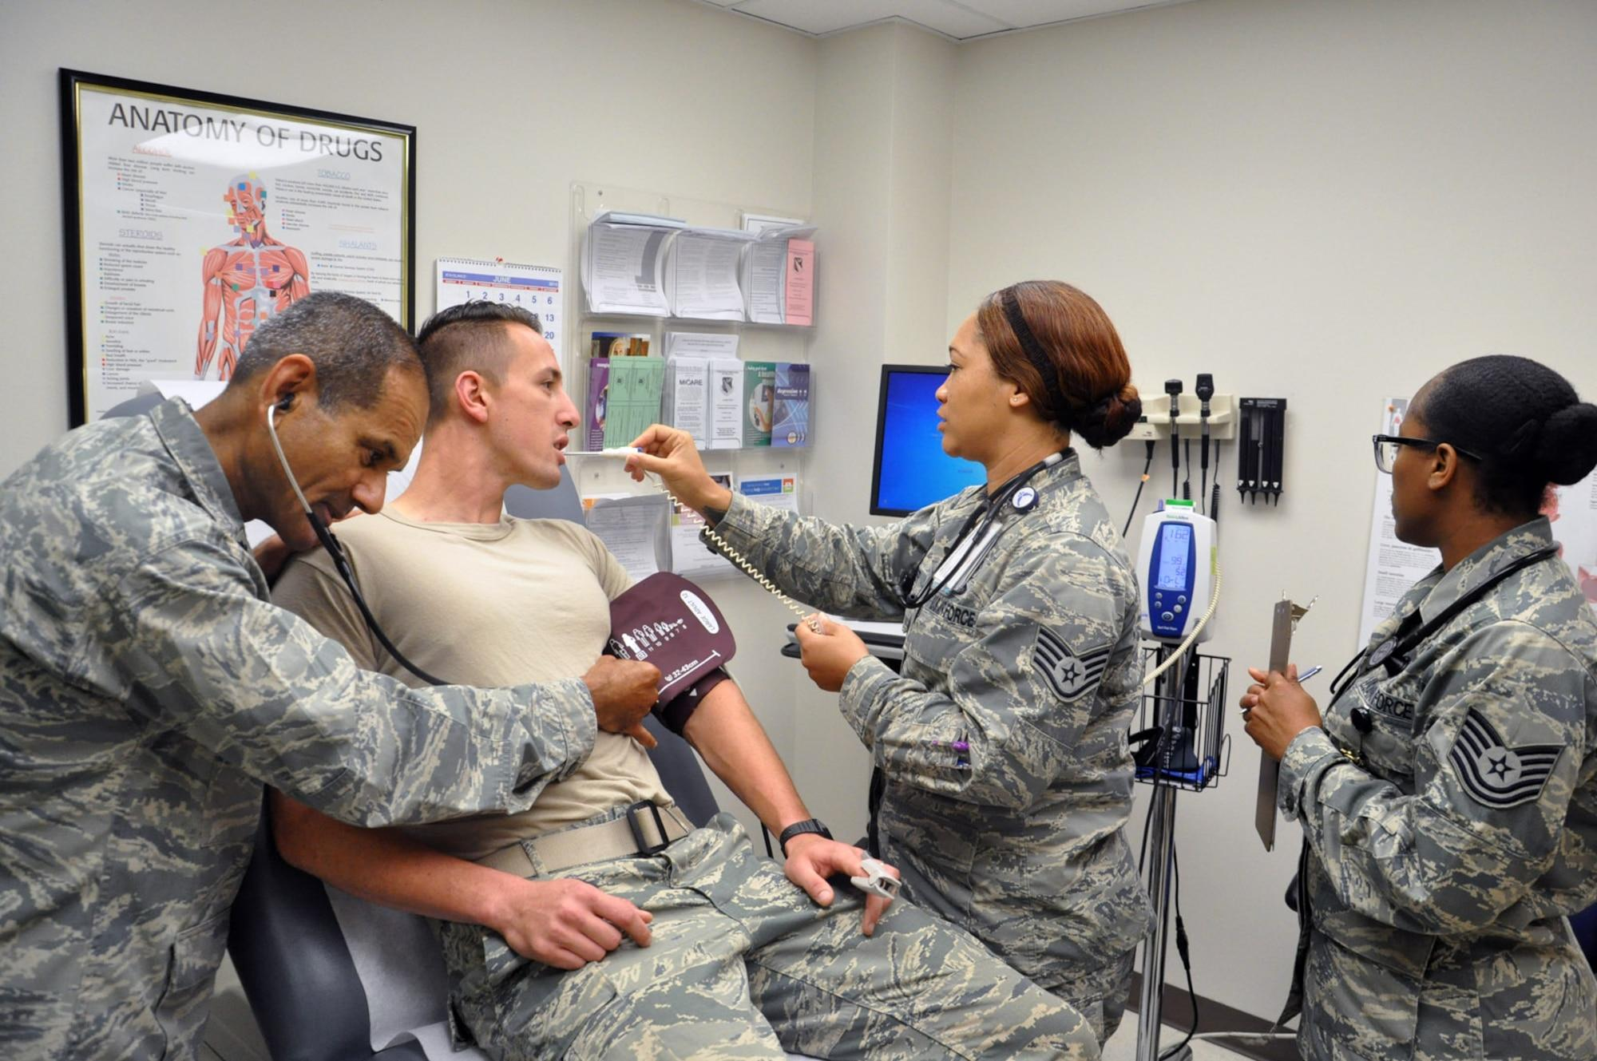
Predictors of VBSN Progression/Graduation
Results
Predicting Student Veteran
Success
Student Military Service Status
Program Delivery Mode
Rurality
Race
Ethnicity - Non-Hispanic
First Generation
Notes:
Individual characteristics in the final logistic regression model included veteran status, race, ethnicity, generation, and rural background.
Student military status (active duty, reservist/national guard, or veteran), rural background, race, ethnicity, and first-generation were not predictive of SV success.
Using a logistic regression model to predict program completion for four Texas VBSN programs including a total of 85 student veterans' records from HRSA reports, we found that the only predictor of student success was program delivery mode (hybrid). In the final analyses, the delivery mode showed a significant impact on the probability of completion (p = .003).

Slide 14
Predictors of VBSN Progression/Graduation
Discussion and Implications
Student Veteran Success
not predicted by:
First generation
Rural background
Age
Military status
Gender
Race and ethnicity
Student Veteran Success promoted by:
Work/family responsibilities
Financial challenges
Veteran-specific resources
Trained faculty, staff, and administrative personnel
Notes:
•Data not available to determine significance of first generation or rural background, however, initial analyses revealed significant associations between the program delivery mode at each institution and student’s rural and disadvantaged backgrounds.
•Age and military status- Larger sample sizes may be needed to determine any relationship between veteran status and program completion.
•In U.S., most nursing programs are represented by women (87%) and men (13%), a converse association noted in the military 84%-men compared to 16%- women. VBSN program reported between 50.5% and 62.2% men.
•In VBSN programs, Hispanic students represented 24% of the student population, compared to 9.8% nationally. Racial minorities were similar to national levels, although previous studies reported 15.1% African American students, demonstrating diversity in the northeast region of the U.S.
Implications:
•Understanding the non-traditional student veterans needs-they may have work or family responsibilities due to lower educational attainment and increased unemployment and poverty rates. Those still serving in the the National Guard/Reserves may still be trying to earn extra income to provide financially for their families. SV may have military-related health issues which require consideration while attending school.
•Veteran-inclusive teaching strategies such as syllabi statements, training faculty, staff and admin personnel to assist with meeting SV specific needs; gathering places for SVs (Veterans’ Resource Center)

Slide 15
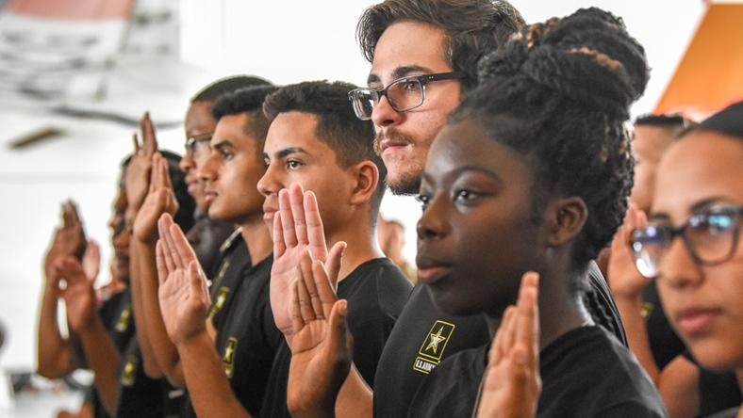
Predictors of VBSN Progression/Graduation
Conclusions
Recruiting veterans increases nursing workforce diversity
Gender
Race
Ethnicity
Notes:
HRSA provided an exciting funding opportunity (2016-2019) to encourage qualified military active duty, Reservists/National Guard, and veterans to enroll in innovative professional nursing programs, although information about their progression and completion from these curricula was limited. Data collection for this study was conducted by requesting VBSN HRSA Annual Reports from four Texas schools. A total of 282 SV records were analyzed. The percentage of male (50.5%) and Hispanic (24%) SVs enrolled in Texas VBSN programs was significantly higher, when compared to national nursing program averages. Almost 50% of SVs (n = 140) completed the programs and another 107 (37.9%) were still enrolled at the termination of grant funding. In this study, program delivery mode (hybrid) was the only predictive factor of program completion. Intentionally recruiting more veterans to nursing could increase the gender, racial, and ethnic diversity of nursing’s workforce.
Encouraging veterans to enter the profession of nursing after their military service could further infuse gender, race, and ethnic diversity into the workforce, something nursing organizations (ANA, AACN, NLN) have struggled to accomplish for decades.

Slide 16
Faculty Perspectives
Background
Military downsizing & GI Bill benefits resulted in ↑ student Veterans
HRSA VBSN Program grants increased enrollment, progression, and graduation of Veterans
31 schools of nursing received funding
Notes:
More student Veterans pursue college degrees because of military downsizing, and Government Issue (GI Bill) benefits (D’Aoust et al., 2016; Gibbs et al., 2019). Nursing is a viable degree option for many veterans.
Capitalizing on the Veteran’s extensive service experience, values, and norms, the Health Resources Services Administration (HRSA) proposed the Nurse Education, Practice, Quality and Retention – Veterans’ Bachelor of Science (VBSN) Program grants. These grants supported schools of nursing to increase enrollment, progression, and graduation of Veterans. Over a 3-year period from 2016 to 2019, 31 schools of nursing received funding. These grants increased Veteran access to the nursing profession and improved their employability by translating knowledge and skills gained during military service. Additionally, the profession benefitted from these student Veteran graduates to expand and diversify the workforce.

Slide 17
Faculty Perspectives
Research Questions
What was the experience of faculty who taught in a VBSN program?
What factors influenced faculty teaching practices and the support provided to student Veterans enrolled in VBSN programs?
How did nursing faculty facilitate student Veterans learning transfer from military service to nursing?
Notes:
The research questions for our study were (read the slide)

Slide 18
Faculty Perspectives
Purpose
Describe & understand the experiences of faculty who are/were teaching in a VBSN program
Describe teaching & learning strategies implemented with student Veterans by faculty who are/were teaching in a VBSN program
Describe faculty facilitation of student Veteran learning transfer from military service to nursing
Notes:
The purpose of our study was threefold. We wanted to:
1.Describe & understand the experiences of faculty who were/are teaching in a VBSN program
2.Describe teaching & learning strategies implemented with student Veterans by faculty who were/are teaching in a VBSN program
3.Describe faculty facilitation of student Veteran learning transfer from military service to nursing

Slide 19
Faculty Perspectives
Methods
Mixed methods descriptive design
Researcher developed survey (α =0.91)
N=52 completed survey
n=9 participated in one semi-structured interview
Notes:
A mixed methods descriptive design, guided by Berry’s acculturation framework (2005), was used to answer the research questions. Invitations to participate in the study were sent to publicly available email addresses of nurse faculty at schools awarded VBSN program funding. Additionally, faculty were recruited from our personal contacts and snowball sampling. The 25-item researcher developed survey entitled, Faculty Knowledge, Skills, and Perceptions Toward Student Veterans was emailed to 1419 faculty teaching in the 31 HRSA funded schools of nursing. A total of 52 nurse faculty returned a completed survey. The survey instrument was pilot tested for content validity and the Cronbach alpha was 0.91.
9 nurse faculty who completed the survey also agreed to participate in a semi-structured interview conducted by two qualitative researchers on our team. Content and thematic analyses of the data attained from the interviews were conducted.

Slide 20
Faculty Perspectives
Results: Research Question #1
Personal/familial experience prepared faculty to teach student Veterans
–Aware of military culture
Mature, diligent students
Connected, committed to these students
Treat like all other students
What was the experience of faculty who taught in a VBSN program?
Notes:
The results for the first research questions were attained from the open-ended questions on the survey in which nurse faculty would elaborate on their responses/thoughts to the Likert questions.
Overall, nurse faculty participants viewed student Veterans positively. Student Veterans were perceived as mature and diligent students who were committed to learning nursing.
Faculty who served in the military or had family who served in the military felt prepared to teach student Veterans, largely because of their awareness of military culture. Faculty that had no experience with the military commented about their commitment to these students as a way of honoring their service.
There were a few contrary comments from participants. One faculty member noted that they didn’t need special information to teach student Veterans while another commented that they treat student Veterans like any other student in the classroom.

Slide 21

Faculty Perspectives
Results: Research Question #2
Preparedness to teach
student Veterans
Knowledge of
military culture
Knowledge of student Veteran challenges & health issues
Discussing military connected health issues
Familiar with campus & national resources
Awareness of unique needs of student Veterans in the classroom
Notes:
The second research question was: What factors influenced faculty teaching practices and the support provided to student veterans enrolled in VBSN programs?
First, we determined whether there were any correlations between survey items. Survey questions were divided into 2 categories: before and after teaching in VBSN programs.
Before teaching in a VBSN program, faculty who were familiar with military culture and unique challenges/health issues associated with military service were more comfortable teaching student Veterans and discussing any health issues related to military service. Further, familiarity with campus and national veteran resources increased preparedness to teach student Veterans. Finally, seeking empirical evidence about student Veterans was only correlated with an awareness of the unique needs of student Veterans in the classroom.

Slide 22

Faculty Perspectives
Results: Research Question #2
Integrating teaching-learning strategies to maximize learning transfer correlated with
O
Ongoing professional development
Familiarity with Veteran resources
Awareness of unique needs of student Veterans
Preparedness to teach student Veterans
Notes:
After teaching in a VBSN program, faculty who employed teaching-learning strategies to facilitate learning transfer were more like to engage in ongoing professional development related to student Veterans, familiarity with campus/national resources for Veterans, an awareness of unique student Veteran needs in the classroom or clinical and feeling prepared to teach student Veterans.

Slide 23
Faculty Perspectives
Results: Research Question #2
Factor 1
(α = 0.86)
Faculty knowledge needed to
teach student Veterans
Factor 2
(α = 0.76)
Military & Veteran culture
Factor 3
(α = 0.79)
Student Veterans needs
Notes:
Next an exploratory factor analysis was undertaken to understand the interconnectedness of the variables in the survey.
The results of the final factor analysis are seen here on the slide. Each factor was deemed reliable.
Factor 1: Faculty knowledge needed to teach student Veterans
Even before teaching in a VBSN program, faculty respondents reported that they felt prepared to teach student Veterans. This sense of preparedness was connected to an awareness of campus and national resources and professional development related to military culture and student Veterans. As a result of this professional development, faculty were aware of unique needs influencing student Veterans in the classroom and clinical settings. Additionally, some faculty noted that they identified personal biases related to the military & Veteran populations before teaching in a VBSN program.
After starting to teach in a VBSN program, faculty continued to engage in opportunities to learn more about student Veterans and their unique needs. Faculty reported utilizing teaching-learning strategies that facilitated learning transfer from military service to nursing. Some of these strategies included structured teaching plans, clear delineation of student & faculty responsibilities, and providing individualized assistance to students as needed.
Factor 2: Military & veteran culture
Overall, faculty with military experience reported greater knowledge and comfort engaging with student Veterans. This was likely because they could better relate to the experience of serving in the military. It was clear from survey responses that faculty who served perceived an understanding of the factors influencing the student Veteran experience.
Factor 3: Student veteran needs
Faculty with military experience had a greater awareness of student Veteran needs in various learning settings and were more comfortable discussing mental health issues with these students.

Slide 24
Faculty Perspectives
Results: Research Question #3
How did nurse faculty facilitate student
Veteran learning transfer?
Theme 1
Creating a safe place for the student Veteran to learn
Theme 2
Reframing learning through understanding student Veterans’ individuality
Notes:
This slides outlines the two themes generated from the qualitative interviews with 9 nurse faculty who are teaching or previously taught in a VBSN program.
It was clear that nurse faculty took seriously the importance of creating a safe place for student Veterans to learn. To the faculty, a safe learning environment was one that supported learning without judgment, appreciated the uniqueness of each student Veteran, and focused on helping the student Veteran to be successful.
The faculty spoke about meeting the student Veteran where they were at rather than from an arbitrary point that all students should start from. They commented on the importance of avoiding any type of stereotyping or false assumptions about Veterans or military service.
Understanding student Veterans as unique individuals was another theme. Faculty came to appreciate how important it was to frame learning around the student Veterans prior experiences. For some Veterans, prior learning experiences were fragmented as they attempted to coursework around military obligations which meant the student Veteran had little or no experience managing a full course load. Additionally, faculty spoke about reframing learning by helping student Veterans to apply military knowledge and experience to new learning situations and nursing concepts. Faculty spoke about acknowledging traits learned in the military such as teamwork, communication, and leadership to maximize learning transfer.

Slide 25
Faculty Perspectives
Implications for Education
Recruiting nurse faculty, advisors, or student Veteran liaisons with military experience
Understanding military culture is essential to supporting student Veterans & facilitating acculturation into higher education
Providing ongoing professional development to foster Veteran cultural sensitivity
Notes:
Our findings clearly demonstrate that faculty with military experience were comfortable and knowledgeable to positively engage with student Veterans in all settings. The result of which are student Veterans who successfully matriculate and graduate from nursing programs nationally. It stands to reasons that the more academic personnel with military experience that a student Veteran can engage with will increase the likelihood of success in higher education.
Secondly, maintaining knowledge and understanding of military culture, including communication, will increase faculty preparedness to teach student Veterans. Understanding differences between military and civilian values, language, and social interactions are needed to facilitate student Veteran acculturation into higher education.
Ongoing faculty development related to military service and Veterans is vital to assuring veteran cultural sensitivity.

Slide 26
Faculty Perspectives
Conclusions
More Veterans pursuing nursing degrees
Differences between military & civilian culture = difficult transitions for student Veterans into higher education
Faculty prepared to teach student Veterans can facilitate transfer of learning
Notes:
As more Veterans pursue college degrees it is imperative that faculty are prepared to meet unique student Veteran needs. Significant differences between military and academic cultures often translates to a difficult transition to higher education for student Veterans. Nursing faculty are in an ideal position to not only support student Veterans but also maximize learning transfer from military service to their nursing coursework/practice. The result is increased diversification of the nursing workforce.

Slide 27
Nurses Understanding Military Culture/Care
Background
Numerous health risks are associated with military service.
Risks create a significant public health concern due to long-term consequences & higher rates of disability.
Nurses feel unprepared to address health issues associated with military service.
Adequate preparation of nurses to provide veteran-centered care is paramount.
Notes:
National efforts, such as the Joining Forces campaign, began in 2011 to enhance nurses’ knowledge, skills, and attitudes (competence) in the care of military service members, veterans, and their families in response to the prolonged wars in Iraq and Afghanistan. Years after these efforts were initiated, there was significant variation in the ways schools of nursing nationally prepared student nurses to care for veterans. Later, an exploration of veteran content in the most widely adopted prelicensure nursing textbooks revealed that skills and attitude domains of the veteran care competencies were poorly addressed. Despite published veteran-care competencies, nurse faculty continue to report time, lack of expertise, and a content laden curricula as common barriers to integrating veteran health information into courses and curricula. Over time this translates to a nursing workforce that lacks requisite knowledge about veterans, inconsistent assessment of military service, and uncertainty of how to manage patients with previous military service.
Collectively this is a significant public health concern.

Slide 28

Nurses Understanding Military Culture/Care
Purpose
Measure nurses’ and nursing students’ knowledge, skills, attitudes, or confidence in caring for veterans.
Notes:
Our study aimed to (read slide)

Slide 29
Nurses Understanding Military Culture/Care
Research Questions
What are nurses' knowledge, attitudes, and confidence caring for veterans?
What are student nurses' knowledge, attitudes, and confidence caring for veterans?
Notes:
More specifically, the two research questions were (read the slide)

Slide 30
Nurses Understanding Military Culture/Care
Methods
Quantitative, cross-sectional design
Two validated instruments:
Military Cultural Certificate Program (MCCP) scale (Needgaard & Zwilling, 2017)
Health Professionals Attitudes Towards Veterans (HPATV) (Knopf-Amelung et al., 2018)
Notes:
A quantitative, correlational design, guided by Ajzen & Kruglanski’s theory of planned behavior (2019), was used to answer the research questions. Any registered nurse or pre-licensure student nurse who has completed at least one clinical course, able to read and write in English, over 18 years of age were invited to participate. Invitations to participate were posted to publicly available discussion boards such as the AACN and NSNA, the AMSN listserv, and a nursing education conferences. Additionally, participants were recruited from our network of colleagues and snowball sampling.
2 validated instruments were used to collect the data. The MCCP scale includes 26 total questions broken down into two sub-scales measuring knowledge of military culture and confidence during Veteran encounters. Participants rated their level of agreement with each statement using a 6-point Likert scale ranging from strongly agree to strongly disagree. The Cronbach’s alpha for each of the sub-scales is provided on the slide. The Cronbach’s alpha for this study was 0.94 and 0.97 respectively. The HPATV includes 14 Likert-style questions with responses ranging from strongly disagree to strongly agree with neutral in the middle. A confirmatory factor analysis validated three factors within the tool including culture, care, and health. The Cronbach’s alpha for the 3 subscales in this was study were 0.72, 0.83, and 0.69 respectively.
Nurses in clinical or academic education roles took the HPATV. The survey for registered nurses including nurse educators ranged from 52 to 64 questions. The survey taken by prelicensure nursing students totaled 50-questions and included the HPATV and MCCP scales. Demographic information such as age, gender, military service, years of nursing experience and years of teaching experience were also collected. A total of 153 licensed nurses and prelicensure nursing students completed all or part of the survey.

Slide 31
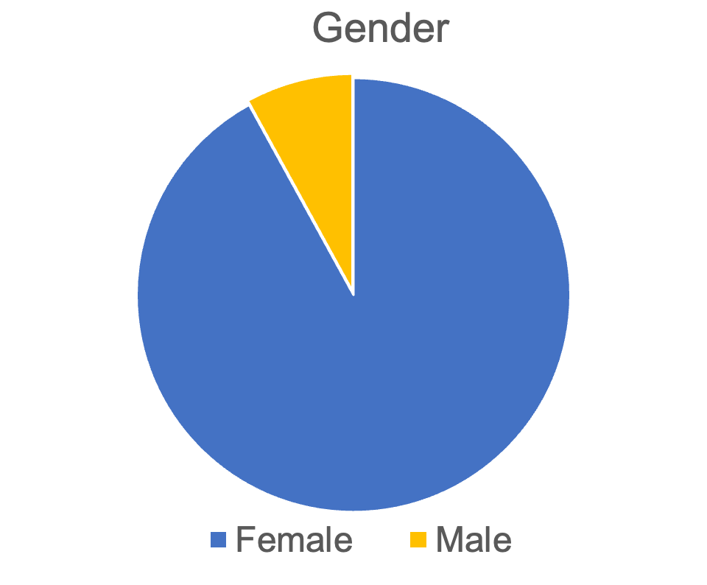
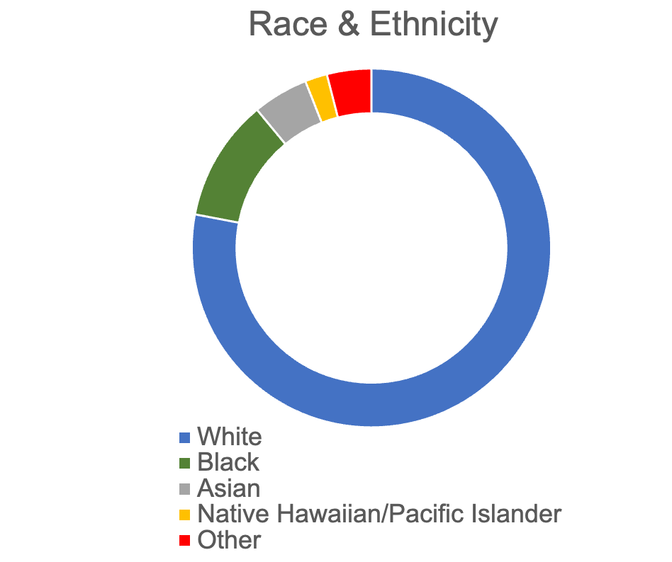
Nurses Understanding Military Culture/Care
Participant Demographics
Notes:
N= 120-150 (some questions not answered by each participant)
91% female, 8% male
95% non-Hispanic
80% white, 11% Black, 4% Asian, 1% Native Hawaiian/PI, <1% American Indian/Alaska Native, 4% other or prefer not to answer

Slide 32
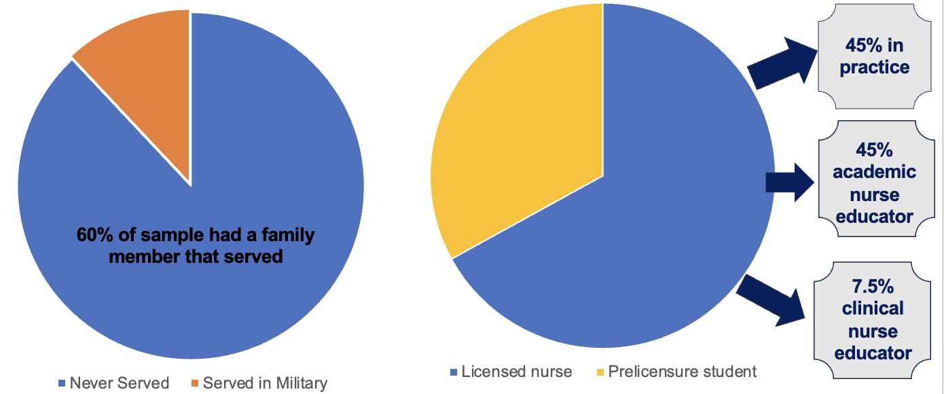
Nurses Understanding Military Culture/Care
Participant Demographics
Notes:
Mean age = 42.5 years
88% never served in military; 60% family member served
65% licensed nurse; 32% prelicensure nursing student
57% practicing nurse, 59% academic nurse educator, 10% clinical nurse educator, <2% post-licensure student (50% BSN, 50% doctorate)
Mean years as a nurse: 22.6 years
Mean years as an academic educator: 11.8 years

Slide 33
Nurses Understanding Military Culture/Care
Research Question #1
 | N | Mean | SD
MCCP: Knowledge | 99 | 3.99 | 1.37
MCCP: Confidence | 98 | 4.86 | 0.90
HPATV: Culture | 96 | 2.96 | 0.99
HPATV: Care | 96 | 3.2 | 0.88
HPATV: Health | 96 | 3.52 | 0.74
What are nurses' knowledge, attitudes, and confidence caring for veterans?
Notes:
Licensed nurses moderately agree that they are knowledgeable about military culture and are comfortable during encounters with Veterans.
Licensed nurses reported largely neutral responses for all 3 factors on the HPATV scale. Questions in the Health factor related to knowledge and feelings toward health issues prevalent in the Veteran population such as PTSD, military sexual trauma, and substance use. The Health subscale was the most highly rated factor on the HPATV among licensed nurses.
Conversely, questions in the culture subscale relate to awareness of and comfort with military culture representing cognitive and affective attitude components. This subscale of the HPATV had the lowest mean scores among licensed nurses.

Slide 34
Nurses Understanding Military Culture/Care
Research Question #2
 | N | Mean | SD
MCCP: Knowledge | 46 | 4.17 | 1.03
MCCP: Confidence | 46 | 5.13 | 0.66
HPATV: Culture | 42 | 2.89 | 0.91
HPATV: Care | 42 | 3.27 | 0.67
HPATV: Health | 42 | 3.64 | 0.61
What are
student nurses' knowledge, attitudes, and confidence caring for veterans?
Notes:
Responses on the MCCP reveal that student nurses agree that they maintain knowledge of military culture and moderately agree that they are confident during encounters with military Veterans.
Like licensed nurses, student nurses expressed the highest agreement with statements in the Health subscale of the HPATV. Student nurses expressed near neutral agreement to items in the Care subscale.
Items in the Care subscale correspond with how health professionals provide care to veteran patients and relate to behavioral intentions such as knowledge of community-based services, screening for a history of military service, asking permission to discuss military-related health issues, and staying current on literature regarding veteran health issues.

Slide 35
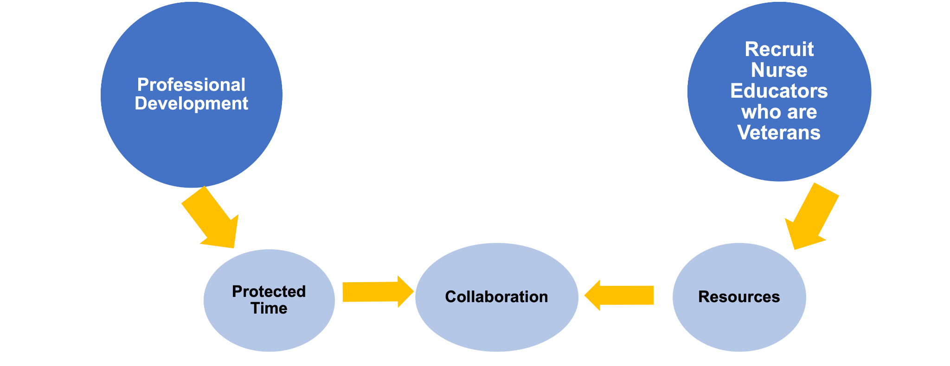
Nurses Understanding Military Culture/Care
Implications
Notes:
Data from our study suggest that more purposeful professional development related to military culture and veteran care is needed. Licensed nurses do not perceive that they have the requisite knowledge and awareness of military culture. We know from our programs of research that a clear understanding of military culture directly underpins one’s ability to provide veteran-centered care. And while pre licensure students believe they are knowledgeable about military culture and are confident to care for Veterans, neutral agreement on questions related to assessing military service and staying current on veteran-health issues suggests more work needs to be done to prepare new graduates nurses to care for veterans in any setting. Threading veteran content across curricula is one way to improve preparedness to care for veterans.
Yet significant barriers persist in higher education which reduce the likelihood that new graduate nurses will be prepared to care for veterans. Nurse faculty believe that a lack of time, a saturated curriculum, and lack of knowledge may interfere with integration of the veteran-care competencies into courses or curricula. To that end we advocate for protected time to assess curricular gaps and collaborate to develop teaching-learning strategies to address the veteran competencies. Small changes in current pedagogies are all that is needed. For example: change a simulated patient in a psychiatric/mental health course to be a Veteran. Clinical faculty should expect that students ask each if they have ever served and provide opportunities to practice taking a military health history. Or perhaps discuss how exposures during different eras of service are connected to cancers decades later.

Slide 36
Recommendations
Faculty/Staff Resources
Provide faculty and staff development
Employ a campus Veteran Liaison
Hire faculty and staff with prior military service
Award competency-based credit for military education and experiences
Notes:
Psycharmor- Free online military culture courses
ACE

Slide 37
Research Gaps/Opportunities
Promoting military cultural and training in higher education
Forming research teams to focus on student Veterans
Identifying retention strategies for student Veterans
Securing student Veteran research funding
Attracting student and alumni Veteran study participants
Notes:
Our program of study has produced evidence of several research opportunities.
How are other programs/schools promoting the inclusion of military culture training and awareness in higher education? What tools have proven most successful? How is the success measured?
How are student Veteran research teams being formed? Are there are other teams whose primary focus of research is student Veterans?
What retention strategies for student Veterans promote success?
What additional funding opportunities are available to support student Veterans research?
How can we attract student and alumni Veteran study participants?
Does the mode of delivery impact student Veteran performance?

Slide 38

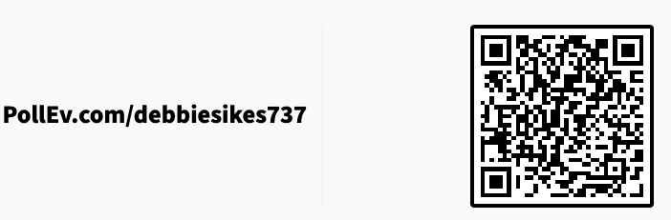
Polling
Notes:
https://PollEv.com/free_text_polls/kfDL53ibKdrhavLA8NH0G/respond

Slide 39

Questions

Slide 40
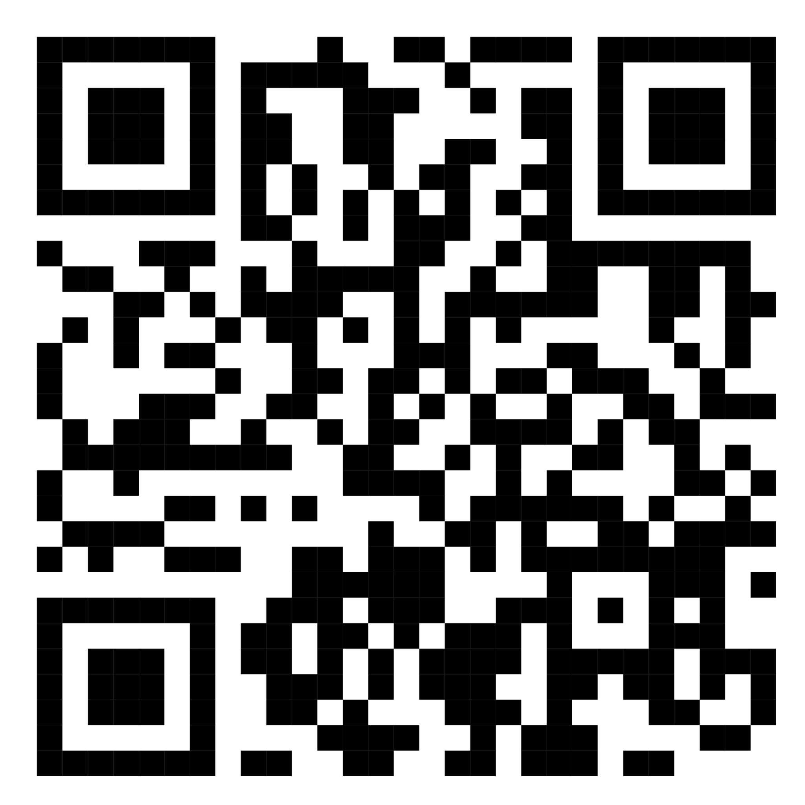
References

