Slide 1
SBARE –
who we are
and what we do
State Board of Agricultural Research and Education
July 2023

Slide 2
History
Established by legislative decree in 1997 as the State Board of Agricultural Research (SBAR) responsible for budgeting and policy-making associated with the supervision of the North Dakota Agricultural Experiment Station.
SBAR

Slide 3
History
Law was changed to include responsibility for the North Dakota State University Extension Service during the 1999 legislative session. The State Board of Agricultural Research (SBAR) became the State Board of Agricultural Research and Education (SBARE).
SBARE

Slide 4
Duties
Determine the causes of any adverse economic
impacts on crops and livestock produced in the state
Develop ongoing strategies for the provision of
research solutions and resources to negate adverse
economic impacts on crops and livestock produced in
this state
Develop proactive strategies for NDSU Extension to fulfill the mission of improving the lives and livelihood of the citizens of North Dakota by providing research-based education
SBARE

Slide 5
Duties
Implement the strategies developed under subsections
2 and 3, subject to approval by the State Board of
Higher Education (SBHE)
Develop, with the North Dakota Agricultural Experiment
Station and NDSU Extension, an annual budget for the
operations of these entities
Develop a biennial budget request based on its prioritized needs list and submit that request to the President of NDSU and the SBHE, and forward its prioritized needs list and request without modification to the Office of Management and Budget and the appropriations committees of the legislative assembly
SBARE

Slide 6
Duties
Maximize the use of existing financial resources,
equipment, and facilities to generate the greatest
economic benefit from research and extension efforts
and to promote efficiency
Annually evaluate the results of research and
extension activities and expenditures, and report the
findings to the Legislative Council and the SBHE
SBARE

Slide 7
Duties
Advise the President of NDSU regarding the
recruitment, selection and performance of the Vice
President for Agricultural Affairs, NDSU Extension
Director and the Station Director
Provide a status report to the budget section of the
Legislative Council
SBARE

Slide 8
Membership
NDSU President or the President’s designee
NDSU Vice President for Agricultural Affairs*
North Dakota Agricultural Experiment Station Director*
NDSU Extension Director*
Five people appointed by Ag Coalition
Five people appointed in the geographic areas
represented by NDSU Extension’s multicounty program
units
North Dakota Agriculture Commissioner*
Two members of the legislative assembly appointed by
the chair of Legislative Council
*serve in ex-officio, nonvoting capacity
SBARE

Slide 9
Current Members
Jim Bahm, New Salem
Doug Bichler, Linton
David Cook, Fargo
John Dhuyvetter, Minot
Doug Goehring, Bismarck
Pam Gulleson, Rutland
Larry Hoffmann, Wheatland
Jerry Klein, Fessenden
Greg Lardy, West Fargo
Sarah Lovas, Hillsboro
Alisa Mitskog, Wahpeton
John Nordgaard, Bottineau
Scott Ouradnik, Amidon
Mark Urquhart, Jamestown
Julie Zikmund, Park River
SBARE

Slide 10
Learn more about SBARE
www.ndsu.edu/vpag/sbare
SBARE

Slide 11
North Dakota Agricultural Experiment Station (NDAES)
Dr. Greg Lardy, Director
Develop and disseminate technology important to
the production and utilization of food, feed, fiber and
fuel from crop and livestock enterprises
Its research enhances the quality of life, sustainability
of production and protection of the environment
SBARE

Slide 12
North Dakota Agricultural Experiment Station
Conduct applied research through academic
departments in the College of Agriculture, Food
Systems, and Natural Resources; the seven Research
Extension Centers and the Agronomy Seed Farm
Work closely with Extension personnel to provide
scientifically-based, unbiased information that is
needed by North Dakota producers and
agribusinesses to make sound management decisions
SBARE

Slide 13
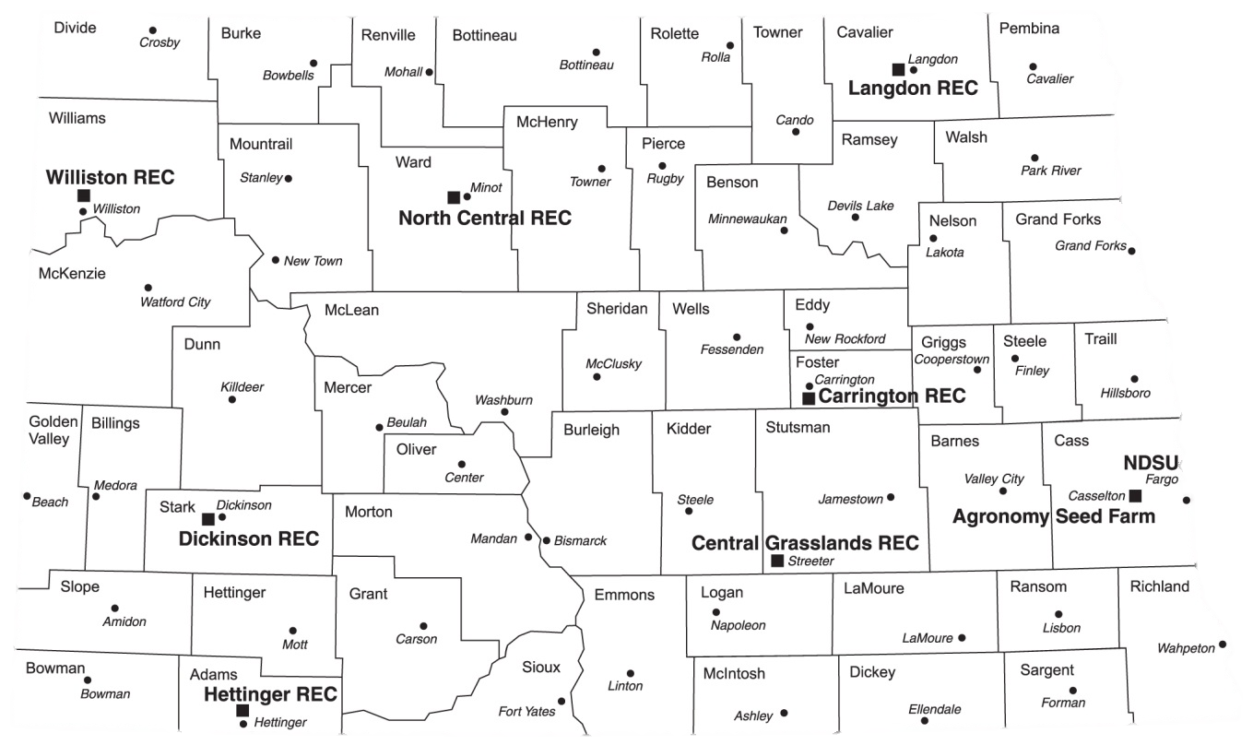
NDAES
Research Extension Centers and Agronomy Seed Farm
SBARE

Slide 14
North Dakota Agricultural Experiment Station
Academic Departments
Agribusiness and Applied Economics
Agricultural and Biosystems Engineering
Animal Sciences
Microbiological Sciences
Plant Pathology
Plant Sciences
School of Natural Resource Sciences
SBARE

Slide 15
North Dakota Agricultural Experiment Station
Areas of Applied Research
Grain and livestock marketing, risk management,
global trade
Bioprocessing, agricultural waste management, irrigation
systems, water management and biofuels
Reproductive physiology, genetics, meat processing,
animal nutrition, range science, natural resource
management
Insect pest management ecology
SBARE

Slide 16
North Dakota Agricultural Experiment Station
Areas of Applied Research
Disease forecasting and management, biological control
of plant diseases, molecular genetics
Plant breeding and genetics, weed science, biotechnology,
crop production and physiology, horticulture
Cereal grain quality, processing, product development
Soil fertility, soil management, wetlands/groundwater
Microbiology, food safety, veterinary diagnostics
SBARE

Slide 17
North Dakota Agricultural Experiment Station
2021-2023 Budget by Source of Funds
Year 2
¹ Excludes capital projects
SBARE

Slide 18

Learn more about the North Dakota Agricultural Experiment Station
www.ndsu.edu/agriculture/ag-research/ag-research
SBARE

Slide 19
NDSU Extension
Dr. Greg Lardy, Director
Empower North Dakotans to improve their lives and communities through science-based education
Disseminate user-friendly information that reflects research efforts at NDSU and across the country
Gear educational programs to the changing needs of North Dakotans
SBARE

Slide 20
NDSU Extension
Faculty and staff on campus work within academic departments of the College of Agriculture, Food Systems, and Natural Resources.
Extension faculty and staff are partners in NDSU’s academic programs and research
Staff in county Extension offices and Research Extension Centers across the state complete the link between campus and North Dakota citizens
SBARE

Slide 21
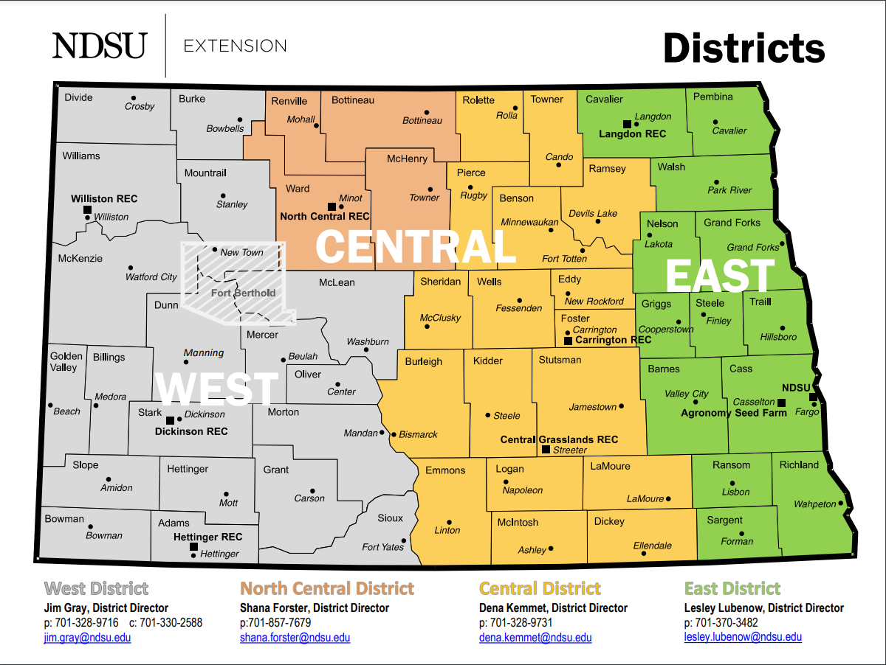
NDSU Extension Districts as of March 1, 2023
SBARE

Slide 22
NDSU Extension
Program Areas
Crop Management
Farm Business Management
4-H Youth Development
Horticulture and Forestry
Human Development and Family Science
Leadership and Civic Engagement
Livestock Management
Natural Resource Management
Nutrition, Food Safety and Health
SBARE

Slide 23

2021-2023 Budget by Funding Source
Year 2
SBARE

Slide 24
Learn more about
NDSU Extension
www.ndsu.edu/agriculture/extension
SBARE

